Slide 1
Parent Projects
Building Memories – Building Minds

Slide 2
Pokémon Cards
Parent Project

Slide 4
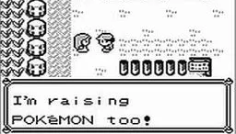
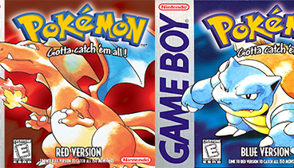
Where did Pokémon come from?
In 1996 Satoshi Tajiri created a game development company called Game Freak and set about coding a game based on his favourite boyhood hobby – insect collecting.
Pokémon, short of Pocket Monsters, was the result.
It was partly also inspired by seeing two Game Boys linked up in a network to allow sharing of files.
It quickly became extremely popular!
It was released with two different games – Pokémon Red and Pokémon Blue.

Slide 5
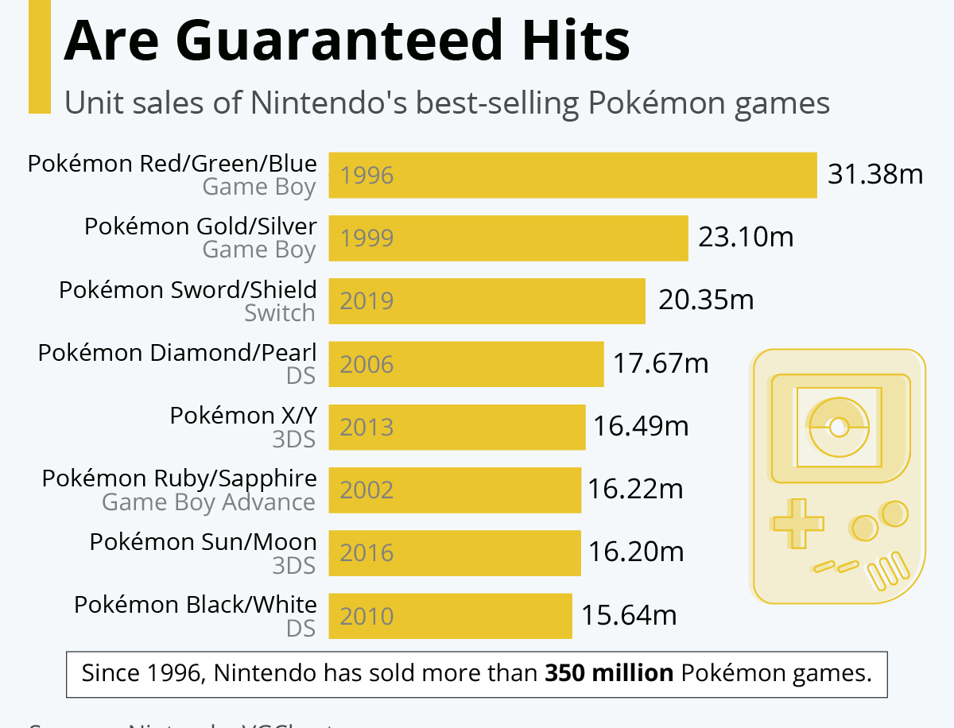
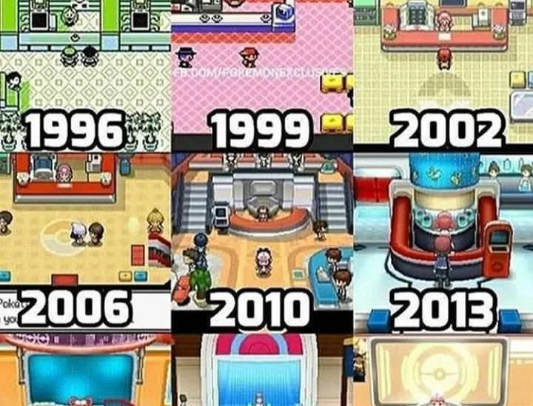
Pokémon's success.
As of 2022 there have been 122 games in the Pokémon series. Numerous cartoons, movies and a thousands of different types of merchandising.
QUESTION:
How many Pokémon games were sold in total on the original Game Boy?

Slide 6
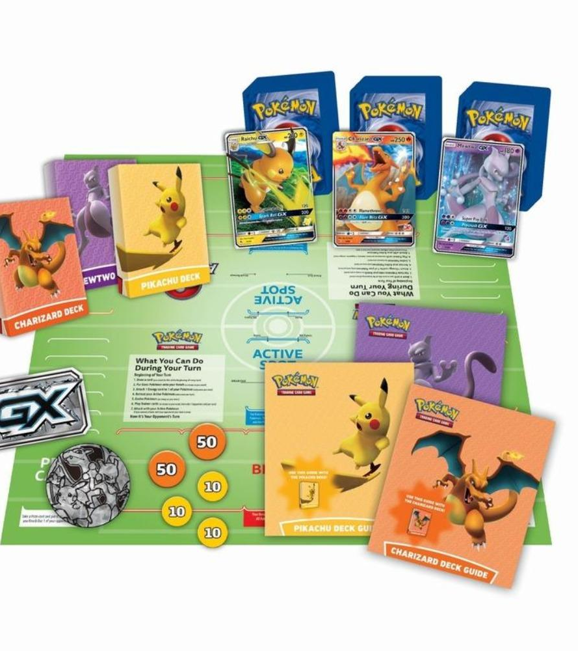
Pokémon Card Game
At the same time as the original game release in 1996 the TCG (Trading Card Game) was also released. It quickly became a favourite of hobbyists around the world – with rare cards reaching crazy prices. In 2022 the most expensive card was sold for $900,000.

Slide 7
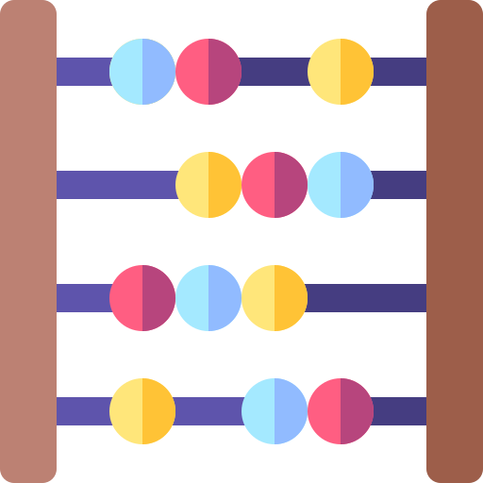
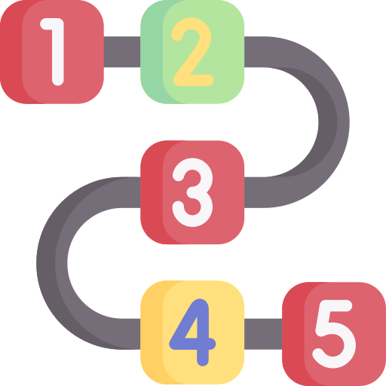
Benefits to young children of playing the game…
Math – Each Pokémon's attack scores a number of HP (Health Point) hits on the opponent – subtracting the value of the attack from the Pokémon's starting HP and recording it using counters is excellent for maths.
Socialising – It is excellent for ‘father/son’. It encourages other off topic conversations and is useful ‘non-screen’ time for my son’s development. I really enjoy playing with him!
Classification – Pokémon are classified according to type. My 5 year old is now an expert and sorting his packs into the different categories – and then within each category – ranking them in strength order.
Reading – The vocabulary used in Pokemon can be quite challenging and expose them to words like ‘resistance’, ‘immensely’ and ‘overwhelming’ that they would not normally encounter. The ‘Trainer Cards’ are vital to winning the game and involve the player reading the instructions aloud.
Analytical Thinking – it is a game of chance and strategy. Choosing when to move a Pokémon forward to battle and when it withdraw them depends a lot on what else you have on your ‘bench’ and what you believe your opponent is able to attack you with.

Slide 8
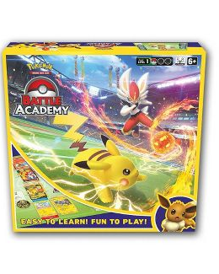
Where should you start? How do you play?
My advice would be to buy the ‘Pokémon Battle Academy’ box set which costs around $20-30. It includes everything you need to start playing, including 180 cards.
How to play? Watch the tutorial….
https://www.youtube.com/watch?v=FDqDvvJyY2w
Too complex?
I play with my 5-year-old and have changed the rules slightly to make it a bit easier to understand. For example, I don’t evolve the cards, but allow him to play any card he draws. I also tend not to bother with conditions or special energy cards. Each family I think will adapt the rules to their own needs, so just pick up and play!

Slide 9
Enjoy!

