Slide 1



Quick Start Guide:
Pupils lining up at the door? Not had your coffee yet?
Follow our quick start guide…
1
Print and copy the 12 mark guidance sheet for pupils who need assistance. (slide 24)
2
Check these links are valid and have them ready to play in browser:
https://www.youtube.com/watch?v=euRlmTHpSCI
https://www.youtube.com/watch?v=m1pplBZu0oU
3
Put up title slide, meet students at door and instruct them to begin the Literacy/Numeracy settler task.

Slide 2

The Battle of Britain and radar, 1940
Warm Up
LO: Examine the factors behind Britain’s victory in the Battle of Britain.
Luftwaffe: The name of the German air force. (add to glossary in back of book (BOB)).
Knowledge
Check
Prime Minister Winston Churchill.
1940.
Q: What do you think Churchill meant by this statement?
SPAG?
Copy and correct.
“We shall defend are island, whatever the cost may be, we shall fight on the beachs, we shall fight on the landing grounds, we shall fight in the feilds and in the streets, we shall fight in the hills; we shall never surrender.”
Numeracy:
The Royal Air Force (RAF) had 3000 pilots at the start of the battle. 544 were lost in fighter missions, 700 in bombing missions and 300 in coastal protection. How many were lost in total? What percentage of the whole were lost?
Write
Peer
Homework
CHECK
Finished? – Try this..
In aircraft battles, what is more important, quantity or quality of aircraft?

Slide 3
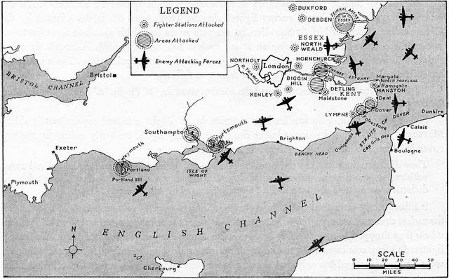
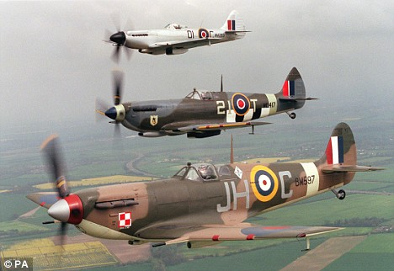
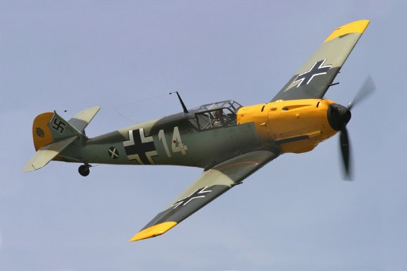
What was the Battle of Britain?
Warm Up
It happened in 1940. It was part of the wider German plan to invade Britain. The Germans called it Operation Sea Lion.
The first step was to destroy the Royal Air Force so German troops and ships could easily move across the English Channel…
Knowledge
Check
WATCH
https://www.youtube.com/watch?v=euRlmTHpSCI
Write
Peer
Homework
CHECK
Finished? – Try this…
Why in history have people found it difficult to invade Britain?
(But it’s not impossible: 1066 and 1688)

Slide 4

Prioritise the factors…
Warm Up
Operation Sea Lion failed and Hitler soon gave up on his plans to invade Britain – why?
Knowledge
You are about to see six reasons why Hitler’s plan failed.
You have to individually create a pyramid of the reasons with the those at the top being the most important.
You can write the letter of the reason down but try to note down important facts – it will help with the next task.
Next you will work with a partner to agree on just the top three.
Then you will work in your tables to agree on just one most important reason.
1
Check
2
1
2
3
Write
3
4
5
6
Peer
4
Homework
5
CHECK
Finished? – Try this…
What attributes (characteristics) would you want in a good fighter air craft?

Slide 5
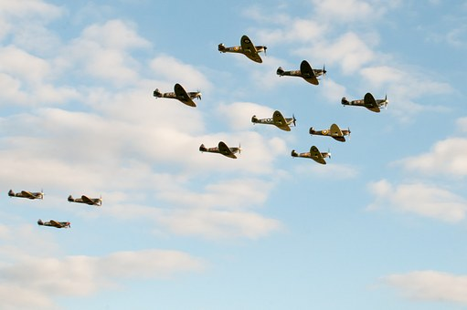
Why did Britain win? – Prioritise the factors…
Warm Up
A
B
C
The Spitfire could turn faster in the air than the German Messerschmitt fighters could.
During the earlier sea battle around Norway the Royal Navy had sunk many German transport ships (needed to move men).
The British had invented radar to guide their aircraft. This allowed them to make maximum use of their aircraft and compensated for having fewer than the Luftwaffe.
Knowledge
Check
D
E
F
Write
The RAF was supported by over two hundred Polish and Czech pilots who had escaped their occupied countries and wanted to help fight the Germans.
The Luftwaffe changed their tactics half way through the battle and put their focus on bombing cities – not the RAF’s airfields – giving the RAF time to repair aircraft.
The Americans, who were not in the war at this time, sent 11 pilots to fly spitfires and help Britain.
Peer
Homework
CHECK
Finished? – Try this…
What would be more important for Britain – shooting down a few German bombers before they dropped their bombs or lots of German aircraft after they had dropped their bombs?

Slide 6
Prioritise the factors…
Warm Up
Operation Sea Lion failed and Hitler soon gave up on his plans to invade Britain – why?
Knowledge
You are about to see six reasons why Hitler’s plan failed.
You have to individually create a pyramid of the reasons with the those at the top being the most important.
You can write the letter of the reason down but try to note down important facts – it will help with the next task.
Next you will work with a partner to agree on just the top three.
Then you will work in your tables to agree on just one most important reason.
1
Check
2
1
2
3
Write
3
4
5
6
Peer
4
Homework
5
CHECK
Finished? – Try this…
What attributes (characteristics) would you want in a good fighter air craft?

Slide 7

Mini Plenary:
Think/Pair/Share
Warm Up
Knowledge
Why do you think German pilots claimed the RAF had more aircraft than they thought?
Why would the ability to turn quickly make the spitfire a good ‘dog-fighter’?
What was the most important reason for British victory – why?
Don’t forget the Lesson Objective!
We want to be able to examine the factors behind Britain’s victory.
Check
Write
Peer
Homework
Finished? – Try this…
Select one ‘factor’ as being the most responsible for starting the Second World War and explain why.
CHECK

Slide 8
Explain why Nazi Germany abandoned its plans to invade Britain in 1940. (12 marks)
You may use the following:
Spitfire
Radar
Warm Up
How do we structure 12 mark questions?
Look back at the feedback you were given for your Causes of the Second World War question.
Knowledge
Check
TOP TIP
You must write about three different factors.
They have given you two pieces of evidence.
EVIDENCE IS NOT THE SAME THING AS A FACTOR.
You must decide what the three factors are and then place the evidence in the correct heading.
For example – Russian Revolution is evidence, but ‘Communism’ might be the factor you choose to talk about.
TOP TIP
A short introduction:
  List the three factors you will be talking about.
Factor 1 (PEEL)
Factor 2 (PEEL)
Factor 3 (PEEL)
Conclusion:
  Explain how the factors link together and which was the most important.
Write
Peer
Homework
CHECK

Slide 9
Explain why Nazi Germany abandoned its plans to invade Britain in 1940 (12 marks)
You may use the following:
Spitfire
Radar
Warm Up
Knowledge
MODEL PARAGRAPH (PEEL):
One factor that made the Germans abandon the idea of invading Britain was Britain’s use of technology. The British had developed radar that allowed them to guide their aircraft to intercept the Luftwaffe. This was important because Britain did not have many aircraft and it was important the few it had could find the enemy quickly rather than waste time flying around looking for them. This contributed to Nazi Germany giving up its plans as they found it difficult to bomb Britain without their bomber aircraft being shot down first.
Check
Write
Peer
Homework
CHECK
Think: What has the student done well in the example paragraph above?

Slide 10
Explain why Nazi Germany abandoned its plans to invade Britain in 1940. (12 marks)
You may use the following:
Spitfire
Radar
Warm Up
Knowledge
MODEL PARAGRAPH (PEEL):
One factor that made the Germans abandon the idea of invading Britain was Britain’s use of technology. The British had developed radar that allowed them to guide their aircraft to intercept the Luftwaffe. This was important because Britain did not have many aircraft and it was important the few it had could find the enemy quickly rather than waste time flying around looking for them. This contributed to Nazi Germany giving up its plans as they found it difficult to bomb Britain without their bomber aircraft being shot down first.
Check
Write
Peer
Homework
CHECK
Point
Evidence
Explain
Link to the question

Slide 11
Explain why Nazi Germany abandoned its plans to invade Britain in 1940. (12 marks)
You may use the following:
Spitfire
Radar
Warm Up
Knowledge
TOP TIP
You must write about three different factors.
They have given you two pieces of evidence.
EVIDENCE IS NOT THE SAME THING AS A FACTOR.
You must decide what the three factors are and then place the evidence in the correct heading.
For example – Russian Revolution is evidence, but ‘Communism’ might be the factor you choose to talk about.
TOP TIP
A short introduction:
  List the three factors you will be talking about.
Factor 1 (PEEL)
Factor 2 (PEEL)
Factor 3 (PEEL)
Conclusion:
  Explain how the factors link together and which was the most important.
Criteria tips:
Each paragraph must clearly link to the question.
Must include detailed facts/figures/dates/names for the period.
Challenge yourself! –Try to use these words in your answer:
Consequence
Repercussions
Contributed
Tensions
Check
Write
Peer
Homework
CHECK

Slide 12
Peer assessment.
Warm Up
Knowledge
PUPIL CRITERIA
Level 1: Some simple points made.
Level 2: There is a structure and some evidence has been used to support points.
Level 3: Paragraphs include some explanation about why the factors made a war more likely/lots of details are used.
Level 4: All paragraphs are clearly and successfully linked to the answer and the conclusion shows how different factors had an impact on each other.
WWW/EBI
starter sentences..
You have included some good detail, for example…
You have explained the factor well, for example you have written…
Your conclusion shows how the different factors linked together, for example you have written…
Check
Write
Peer
Homework
CHECK
Finished? – Try this…
Why do you think Britain was able to fight off the Nazis when France were not?

Slide 13
Homework.
Warm Up
Knowledge
FLIP LEARNING SHEET
Check
Write
Peer
Homework
Due for?
CHECK

Slide 14

Did we meet our LO?
Warm Up
LO: Examine the factors behind Britain’s victory in the Battle of Britain.
Knowledge
THUMBS UP = TRUE
THUMBS DOWN = FALSE
Check
The Messerschmit could turn faster in the air than the Spitfire fighters could.
The Luftwaffe began bombing cities but soon switched to bombing airfields.
Pilots from Poland the Czechoslovakia played an important role.
Write
Peer
The German plan to invade Britain was given the code name: Sea Lion.
The RAF had more aircraft than the Luftwaffe at the start of the war.
The campaign in Norway was not a complete disaster for Britain.
Homework
Finished? – Try this…
Was bombing cities justified or a ‘war crime’?
CHECK

Slide 15

Worth a watch:
The first Polish migrants:
Polish pilots in Britain – 1940
Warm Up
Knowledge
Check
Write
https://www.youtube.com/watch?v=m1pplBZu0oU
Peer
Homework
CHECK

Slide 16
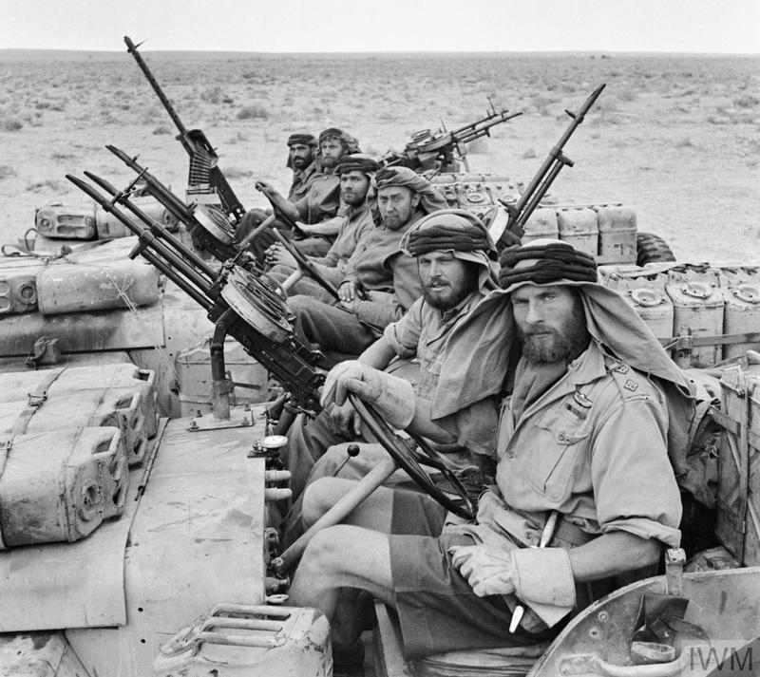
Next Lesson…
Africa, El Alamein and the creation of the SAS
Warm Up
Knowledge
Check
Write
Peer
Homework
CHECK

Slide 17
RESOURCES

Slide 18
Why did Britain win? – Prioritise the factors…
A
B
C
The Spitfire could turn faster in the air than the German Messerschmitt fighters could.
During the earlier sea battle around Norway the Royal Navy had sunk many German transport ships (needed to move men).
The British had invented radar to guide their aircraft. This allowed them to make maximum use of their aircraft and compensated for having fewer than the Luftwaffe.
D
E
F
The RAF was supported by over two hundred Polish and Czech pilots who had escaped their occupied countries and wanted to help fight the Germans.
The Luftwaffe changed their tactics half way through the battle and put their focus on bombing cities – not the RAF’s airfields – giving the RAF time to repair aircraft.
The Americans, who were not in the war at this time, sent 11 pilots to fly spitfires and help Britain.

Slide 19
Pre-written feedback slips for printing; Circle the correct grade.
1/2/3
WWW: You have included some basic points/facts about some of the factors.
EBI: Make sure you explain WHY the factors were important.
1/2/3
WWW: You have included some basic points/facts about some of the factors.
EBI: Make sure you explain WHY the factors were important.
1/2/3
WWW: You have included some basic points/facts about some of the factors.
EBI: Make sure you explain WHY the factors were important.
1/2/3
WWW: You have included some basic points/facts about some of the factors.
EBI: Make sure you explain WHY the factors were important.
1/2/3
WWW: You have included some basic points/facts about some of the factors.
EBI: Make sure you explain WHY the factors were important.
1/2/3
WWW: You have included some basic points/facts about some of the factors.
EBI: Make sure you explain WHY the factors were important.
1/2/3
WWW: You have included some basic points/facts about some of the factors.
EBI: Make sure you explain WHY the factors were important.
1/2/3
WWW: You have included some basic points/facts about some of the factors.
EBI: Make sure you explain WHY the factors were important.
1/2/3
WWW: You have included some basic points/facts about some of the factors.
EBI: Make sure you explain WHY the factors were important.
1/2/3
WWW: You have included some basic points/facts about some of the factors.
EBI: Make sure you explain WHY the factors were important.
1/2/3
WWW: You have included some basic points/facts about some of the factors.
EBI: Make sure you explain WHY the factors were important.
1/2/3
WWW: You have included some basic points/facts about some of the factors.
EBI: Make sure you explain WHY the factors were important.

Slide 20
Pre-written feedback slips for printing; Circle the correct grade.
4/5/6
WWW: You have provided an explanation and used some accurate examples.
EBI: Make sure that ALL your paragraphs explain why the factors had a part to play/connect to what the question is asking.
4/5/6
WWW: You have provided an explanation and used some accurate examples.
EBI: Make sure that ALL your paragraphs explain why the factors had a part to play/connect to what the question is asking.
4/5/6
WWW: You have provided an explanation and used some accurate examples.
EBI: Make sure that ALL your paragraphs explain why the factors had a part to play/connect to what the question is asking.
4/5/6
WWW: You have provided an explanation and used some accurate examples.
EBI: Make sure that ALL your paragraphs explain why the factors had a part to play/connect to what the question is asking.
4/5/6
WWW: You have provided an explanation and used some accurate examples.
EBI: Make sure that ALL your paragraphs explain why the factors had a part to play/connect to what the question is asking.
4/5/6
WWW: You have provided an explanation and used some accurate examples.
EBI: Make sure that ALL your paragraphs explain why the factors had a part to play/connect to what the question is asking.
4/5/6
WWW: You have provided an explanation and used some accurate examples.
EBI: Make sure that ALL your paragraphs explain why the factors had a part to play/connect to what the question is asking.
4/5/6
WWW: You have provided an explanation and used some accurate examples.
EBI: Make sure that ALL your paragraphs explain why the factors had a part to play/connect them to what the question is asking.
4/5/6
WWW: You have provided an explanation and used some accurate examples.
EBI: Make sure that ALL your paragraphs explain why the factors had a part to play/connect to what the question is asking.
4/5/6
WWW: You have provided an explanation and used some accurate examples.
EBI: Make sure that ALL your paragraphs explain why the factors had a part to play/connect them to what the question is asking.
4/5/6
WWW: You have provided an explanation and used some accurate examples.
EBI: Make sure that ALL your paragraphs explain why the factors had a part to play/connect to what the question is asking.
4/5/6
WWW: You have provided an explanation and used some accurate examples.
EBI: Make sure that ALL your paragraphs explain why the factors had a part to play/connect them to what the question is asking.

Slide 21
Pre-written feedback slips for printing; Circle the correct grade.
7/8/9
WWW: You have explained your answer well throughout the question and used detailed facts to support your points.
EBI: Add a conclusion that shows clearly how the different factors are linked and impact each other, try also to explain which was the most influential.
7/8/9
WWW: You have explained your answer well throughout the question and used detailed facts to support your points.
EBI: Add a conclusion that shows clearly how the different factors are linked and impact each other, try also to explain which was the most influential.
7/8/9
WWW: You have explained your answer well throughout the question and used detailed facts to support your points.
EBI: Add a conclusion that shows clearly how the different factors are linked and impact each other, try also to explain which was the most influential.
7/8/9
WWW: You have explained your answer well throughout the question and used detailed facts to support your points.
EBI: Add a conclusion that shows clearly how the different factors are linked and impact each other, try also to explain which was the most influential.
7/8/9
WWW: You have explained your answer well throughout the question and used detailed facts to support your points.
EBI: Add a conclusion that shows clearly how the different factors are linked and impact each other, try also to explain which was the most influential.
7/8/9
WWW: You have explained your answer well throughout the question and used detailed facts to support your points.
EBI: Add a conclusion that shows clearly how the different factors are linked and impact each other, try also to explain which was the most influential.
7/8/9
WWW: You have explained your answer well throughout the question and used detailed facts to support your points.
EBI: Add a conclusion that shows clearly how the different factors are linked and impact each other, try also to explain which was the most influential.
7/8/9
WWW: You have explained your answer well throughout the question and used detailed facts to support your points.
EBI: Add a conclusion that shows clearly how the different factors are linked and impact each other, try also to explain which was the most influential.
7/8/9
WWW: You have explained your answer well throughout the question and used detailed facts to support your points.
EBI: Add a conclusion that shows clearly how the different factors are linked and impact each other, try also to explain which was the most influential.
7/8/9
WWW: You have explained your answer well throughout the question and used detailed facts to support your points.
EBI: Add a conclusion that shows clearly how the different factors are linked and impact each other, try also to explain which was the most influential.
7/8/9
WWW: You have explained your answer well throughout the question and used detailed facts to support your points.
EBI: Add a conclusion that shows clearly how the different factors are linked and impact each other, try also to explain which was the most influential.
7/8/9
WWW: You have explained your answer well throughout the question and used detailed facts to support your points.
EBI: Add a conclusion that shows clearly how the different factors are linked and impact each other, try also to explain which was the most influential.

Slide 22
Pre-written feedback slips for printing; Circle the correct grade.
10/11/12
WWW: You have shown a good line of reasoning throughout your work which leads nicely to a logical and well thought out conclusion.
EBI: In your conclusion you could categorise the factors into long term or short term – and explain why.
10/11/12
WWW: You have shown a good line of reasoning throughout your work which leads nicely to a logical and well thought out conclusion.
EBI: In your conclusion you could categorise the factors into long term or short term – and explain why.
10/11/12
WWW: You have shown a good line of reasoning throughout your work which leads nicely to a logical and well thought out conclusion.
EBI: In your conclusion you could categorise the factors into long term or short term – and explain why.
10/11/12
WWW: You have shown a good line of reasoning throughout your work which leads nicely to a logical and well thought out conclusion.
EBI: In your conclusion you could categorise the factors into long term or short term – and explain why.
10/11/12
WWW: You have shown a good line of reasoning throughout your work which leads nicely to a logical and well thought out conclusion.
EBI: In your conclusion you could categorise the factors into long term or short term – and explain why.
10/11/12
WWW: You have shown a good line of reasoning throughout your work which leads nicely to a logical and well thought out conclusion.
EBI: In your conclusion you could categorise the factors into long term or short term – and explain why.
10/11/12
WWW: You have shown a good line of reasoning throughout your work which leads nicely to a logical and well thought out conclusion.
EBI: In your conclusion you could categorise the factors into long term or short term – and explain why.
10/11/12
WWW: You have shown a good line of reasoning throughout your work which leads nicely to a logical and well thought out conclusion.
EBI: In your conclusion you could categorise the factors into long term or short term – and explain why.
10/11/12
WWW: You have shown a good line of reasoning throughout your work which leads nicely to a logical and well thought out conclusion.
EBI: In your conclusion you could categorise the factors into long term or short term – and explain why.
10/11/12
WWW: You have shown a good line of reasoning throughout your work which leads nicely to a logical and well thought out conclusion.
EBI: In your conclusion you could categorise the factors into long term or short term – and explain why.
10/11/12
WWW: You have shown a good line of reasoning throughout your work which leads nicely to a logical and well thought out conclusion.
EBI: In your conclusion you could categorise the factors into long term or short term – and explain why.
10/11/12
WWW: You have shown a good line of reasoning throughout your work which leads nicely to a logical and well thought out conclusion.
EBI: In your conclusion you could categorise the factors into long term or short term – and explain why.

Slide 23

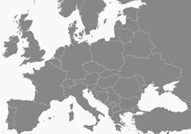




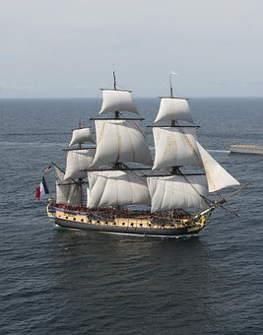
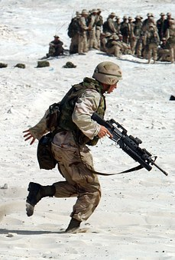


EAL ASSISSTANCE SHEET
Countries:
Europe
Germany
Russia (Soviet Union)
Czechoslovakia
France
Britain
Key verbs:
(to revolt) Revolution
To give a speech.
To farm
To remember
Key nouns:
Peace
Army
Navy
Worker
Family
Can you match the noun to the correct image?
Can you find them on the map?
Can you match the verb to the correct image?

Slide 24

SUPPORT TEMPLATE FOR 12 MARK QUESTIONS.
Use words from the question to help get you started.
List the main factors you will discuss, e.g. “There are three main factors that contributed to Britain’s success, they are aircraft, technology and strategy.”
Structure
Plan your answer, you will need:
THREE FACTORS (not just three pieces of evidence)
Introductions
Explain why the RAF won the Battle of Britain.
You may use the following.
    Spitfire
    Radar
You will also need to include knowledge of your own.
Simple paragraph sentence starters:
Point: One/Another important factor was…
Evidence: For example…
Explain: This was important because…
Link: This contributed to (the question focus) because…
Paragraphs
Introduction
Factor 1: Aircraft.
  Evidence? Spitfire
Factor 2: Technology
  Evidence? Radar
Factor 3: From own knowledge.
  Evidence: From own knowledge.
Conclusion.
Conclusions
DO | DO NOT
Directly answer the Q Explain why one factor was the most important. Compare the factors – show how they overlap and impact each other. | Just ‘state’ that one factor is the most important. Only summarise your argument, Introduce new evidence (do that in your main paragraphs).
For example, here ‘radar’ is the evidence used to support ‘technology’ as a wider factor.

Slide 25
Lesson plan
Teacher: Date: Lesson: Subject: Class:
Contextual information about the group and their previous learning:
First lesson on the Second World War. Class has previously studied the origins and initial events of the Second World War. They have also completed a 12 mark question so this builds on this skill.
Focus of learning/What will progress look like?
Students will answer a twelve mark exam question. In so doing they will demonstrate the new knowledge learnt during the teach the expert activity. They will also incorporate exam technique guidance from the ppt and advice sheet.
What will be assessed? How? When will the students act on this?
Expert teach activity assess pupil’s ability to work with others,.
Mini plenary/check: Class discussion of answers will address any short comings in understanding. Main activity: Students ability to prioritise complex reasons and justify their decisions.
Additional support and challenge: (PP/More Able/SEND/EAL)
Challenge questions throughout the lesson. Literacy challenge during main task for more able. EAL support sheet for applicable students. 12 mark support template for SEND.
Where can I support QWC/Numeracy?
Reading comprehension/ literacy SPAG/numeracy settler activity.
Lesson narrative:
Literacy/Numeracy settler activity → Expert teacher group activity → 12 mark exam question practice → Prioritise and justify plenary.
Homework:

Slide 26

FLIP LEARNING HOMEWORK SHEET
www.wolseyacademy.co.uk
Check out our Virtual Learning Worlds! (coming soon)
Pupils can roam the fields of history, talk to historical characters and investigate the factors behind key events as if they were really there!
Each comes with its own ‘flip learning’ homework sheet so pupils enter the class inspired, intrigued and ready to learn.

Slide 27
WHY BOTHER? PEDAGOGY JUSTIFICATION
Activity | Justification/Evidence?
Clear Lesson Objective and revisited during plenary. | Professor John Hattie’s “visible learning” looks at meta studies of educational approaches. He concludes that having a clear learning objective, that is revisited throughout the lesson, is a more effective method of achieving high outcomes than merely insisting on high expectations ‘in general’ from the class. Visible Learning. John Hattie, 2008.
Mini plenary: Think/Pair/Share – provides thinking time to students. | Kathleen Cotton’s paper Classroom Questioning concludes that “training teachers in increased wait time is positively related to student achievement”. Think/Pair/Share is an effective means of embedding this practice into your lessons. http://www.learner.org/workshops/socialstudies/pdf/session6/6.ClassroomQuestioning.pdf
Expert teacher group work. | Group work is great for building interpersonal skills. However as every teacher knows the phoneme of ‘social loafing’ where a student will work less hard in a group than they would do individually – is all to real. Therefore the ‘expert teacher’ approach tries to counter this tendency by giving each student a predefined role – e.g. becoming an expert in an area the others are not and being responsible for sharing that work.
Pre-made feedback slips. | Professor John Hattie has identified frequent feedback as the “most powerful single moderator that enhances achievement”. (taken from https://cdn.auckland.ac.nz/assets/education/hattie/docs/influences-on-student-learning.pdf. Feedback should be tailored to the individual student’s needs. However, as we all know, teaching is an excessively labour intensive process and finding the time to provide accurate bespoke feedback on all occasions can be difficult. Additionally the speed of feedback is an important factor in its effectiveness. Quick ‘off the shelf’ feedback like this can help form positive feed-back loops for students when teachers would otherwise not have the time to do so. (see: https://www.wired.com/2011/06/ff_feedbackloop/) To this end the ready made feedback slips are intended to form the basis of more detailed feedback – or to play an important if imperfect role in providing quick feedback. The speed
Prioritisation and justification plenary. | Higher level thinking skills required as seen in Bloom’s Taxonomy.
Introducing the 12 mark question in the first lesson or the SOW and revisiting it after a break of several lessons. | A meta-analysis of studies on the impact of repeated practice has found that ‘individuals in spaced practice conditions performed significantly higher than those in massed practice conditions”. This is this SOW tries to equally space practice of the same style of exam questions. The study does however also indicate that the style of the practice makes a huge difference to the impact and that further research was probably required to make a conclusive judgement on how style and repetition of activity interacted. http://psycnet.apa.org/psycinfo/1999-01454-012 Study by John Donovan and John Radosevich.

Slide 28
At a glance… Second World War SOW
Number | 1 | 2 | 3 | 4 | 5 | 6 | 7 | 8 | 9
Title | Causes | Phoney War & Norway | Battle of the Atlantic & Engima | Blitzkreig & Maginot Line | Dunkirk, Vichy & Mers-el-Kebir. | Battle of Britain & Radar | Africa & SAS | Barbarossa | Tehran Conference
Exam Q style or activity style. | 12 mark essay Q (based on Edexcel) |  |  |  |  | 12 mark essay Q (based on Edexcel)
All available at the Wolsey Academy
TES Shop

Slide 29
At a glance… Second World War SOW
Number | 10 | 11 | 12 | 13 | 14 | 15 | 16 | 17 | 18
Title | Italy | D-Day | Berlin | China and Japan | Pearl Harbour | Battle of Midway | Atom Bombs | Holocaust | Iron Curtain
Exam Q style or activity style. |  | 12 mark essay Q (based on Edexcel)
All available at the Wolsey Academy
TES Shop

Slide 30
www.wolseyacademy.co.uk

