Slide 2
What were the causes of Indian Independence? Learning intention: To understand why India wanted independence.
SOLVE
The British ‘Raj’ controlled India from 1858 to 1947. How many years was this?
CORRECT
in 1947 a Man called ghandi led a politikal movement that led to indian Independance
UNDERSTAND
CRITICAL THINKING
Independence
When a country is free to make its own decisions and laws.
Look at the painting the girl is looking at in the picture. What can she see? What do you think she is thinking? What do you think has happened in the painting?

Slide 3
Do not check your book… complete this task from memory… What can you remember about the British in India?
Cops – Write down here every detail YOU can remember.
Robbers – Move around the room and talk to others in the class – what ideas can you ‘steal’ from them?
1 minute
2 minutes

Slide 4
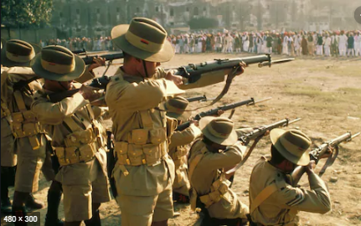
The context: What do you know already?
The East India Company controlled most of India’s natural resources and trade for more than a hundred years.
The British introduced some positive things, like modern medicine and railways.
However, they treated most Indians badly, stopped them from receiving the profits from Indian businesses and would not let them have any say in running their own country.
Causes of Indian Independence
Many Indians began to protest and demand they had more control over their lives. Let’s look more closely at what happened in the 1900s.

Slide 5
Memory is the ‘echo’ of learning
- David T Willingham
We will learn the ‘factors’ behind Indian Independence by completing three* different tasks with one set of resources.

Slide 6
QUIZ QUIZ TRADE What were the causes of Indian Independence?
1. Walk carefully around the classroom
2. Stop and partner up when the teacher says so.
3. Take turns in asking and answering your questions.
(shiniest shoes/longest hair/tallest goes first)
4. Trade question cards and go back to walking carefully.

Slide 7
Timeline Activity
Sort the cards in the order you think they occurred.
Make sure to add in the dates as you do.
When ready, check your answers against the real timeline.
Finished?
Can you prioritise these events? Use the key to shade in each event to show how important you think it must have been. You can re-do this activity at the end of the topic and see if your opinions have changed!
Important
Quite Important
Not that Important
Notes:
Can either print the large slides and have students copy (or photograph?) the timeline. OR, print the small event cards and have the students stick them in their books.

Slide 8
Timeline Answers
Indian Nationalism 1885
British Commission into Home Rule
1917
Amritsar Massacre
April 1919
The First World War 1914
Rowlatt Act
February 1919
Finished?
Can you prioritise these events? Use the key to shade in each event to show how important you think it must have been. You can re-do this activity at the end of the topic and see if your opinions have changed!
Important
Quite Important
Not that Important
Notes:
Can either print the large slides and have students copy (or photograph?) the timeline. OR, print the small event cards and have the students stick them in their books.

Slide 9
Prioritise the factors…
1
2
3
4
5
6
Finished?
Let’s hear what you think!
First half will be hands down – second half will be hands up.

Slide 10
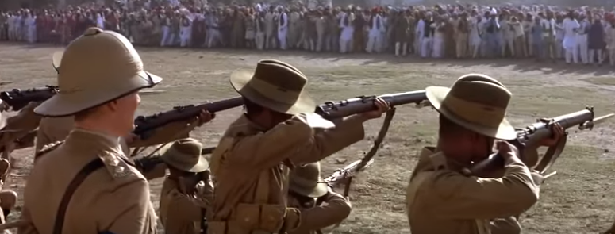
Amritsar Massacre 1919
https://www.youtube.com/watch?v=2LaoamJ3vbs
Consider: Amritsar was a Holy place in the Sikh religion.
What is the British response?
What do you think the consequences will be?
Notes:
If the link has been removed/stopped working search YouTube (or your video site of choice) for ‘Gandhi Amritsar Massacre’ and it will probably pop up.
WARNING – I would stop this just before the British soldiers open fire….

Slide 11
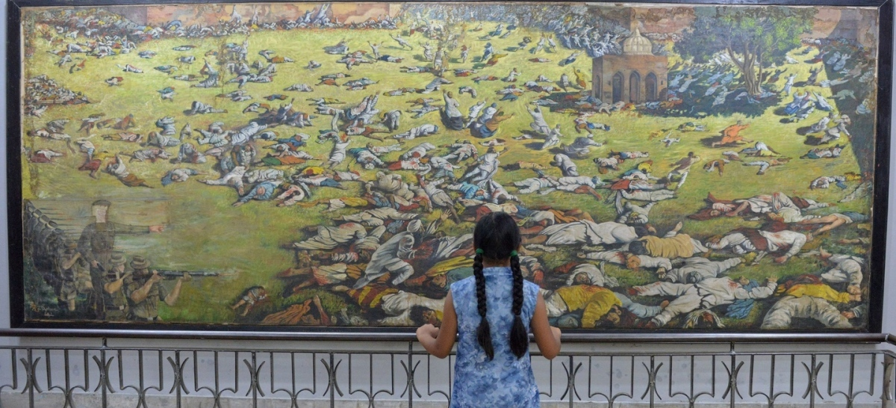
Critical Thinking
Put yourself in their shoes….
What do you think the Indians would be feeling after the Rowlatt Act?
What would be the feeling when the British soldiers arrive?
Consider: Amritsar was a Sikh Holy site & the area has been known as the most ‘loayl’ and ‘pro-British’ part of India.

Slide 12
TRY TO WRITE A ‘PEEKA PARAGRAPH’
Question:
Why did the Indians want independence?
(6 mark Cambridge GCSE Questions)
POINT: (Identify a cause…)
EXAMPLE (Describe what that cause was in more detail):
EXPLAIN: (Explain why this made Indians want independence)
KNOWLEDGE (Use your own knowledge to link to another reason the Indian people wanted independence)
ANSWER (give a direct answer to the question asked)
See the next two slides for a breakdown of how PEEKA paragraphs can help you.

Slide 13
Teacher modelled paragraph!
Question: Why did Indians want independence?
Indians wanted independence because they were growing increasingly frustrated with British rule. For example, in 1885 a group of educated Indians created the Indian National Congress which met often and discussed ways of increasing Indian power. By meeting, they could share ideas and support began to spread across India. In addition many Indians felt betrayed after the First World War when they received no reward for their efforts in helping fight the war. Therefore these two reasons combined to make independence a popular idea in India.
Volunteers to read?

Slide 14
Teacher modelled paragraph!
Question: Why did Indians want independence?
Indians wanted independence because they were growing increasingly frustrated with British rule. For example, in 1885 a group of educated Indians created the Indian National Congress which met often and discussed ways of increasing Indian power. By meeting, they could share ideas and support began to spread across India. In addition many Indians felt betrayed after the First World War when they received no reward for their efforts in helping fight the war. Therefore these two reasons combined to make independence a popular idea in India.
Point
Evidence
Explain
Knowledge (COMPARE)
Answer

Slide 15
Question:
Why did the Indians want independence?
(6 mark Cambridge GCSE Questions)
POINT: (One reason Indians wanted independence was…)
EXAMPLE (For example….)
EXPLAIN: (This made the Indians feel…)
KNOWLEDGE (Another reason the Indians wanted independence was…)
ANSWER (Therefore this made them want independence because…)
Try to use…
Freedom
Power
Control
Frustration
Try not to use…
Angry
Mad
Bully
Think

Slide 16
PEER ASSESSMENT
Why did the Indians want independence?
(6 mark Cambridge GCSE Questions)
POINT: (One reason Indians wanted independence was…)
EXAMPLE (For example….)
EXPLAIN: (This made the Indians feel…)
KNOWLEDGE (Another reason the Indians wanted independence was…)
ANSWER (Therefore this made them want independence because…)
Read through your partner’s work and tick off each ‘PEEKA’ sentence that you can see.
Did they manage to do the whole ‘peeka’?

Slide 17
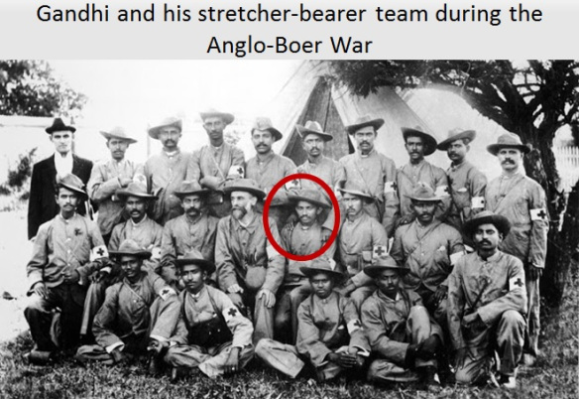
How did this humble and peaceful man take on the mightiest Empire on Earth?
Next topic…

Slide 18
What have you learned today?
Place a post it note on the board – and be ready to justify your comments.
Stretch: Could the British have done anything different? Would it have changed anything?
Num/Lit Settler

Slide 19
Cognitive science
Activity | Theory/Source
Cops and Robbers | . Retrieval Practice - Taken from Kate Jones, ‘Love to Teach’
Context | The power of narrative – Chris Runeckles, ‘Make Every History Lesson Count’
Multiple activities from one resource | David Willingham, ‘Echo of learning’ and with a nod towards cognitive load theory (limiting the information)
QQT | Kagan Strategies
Questioning | Pre-Planned Questioning and higher level thinking – David Fawcett, ‘Relearning to Teach’.
Hands Up/Hands Down (Cold Calling) | From Doug Lemov, ‘Teach like a Champion’
Cliffhanger | Taken from Chris Runeckles, ‘Make Every History Lesson Count’

Slide 20
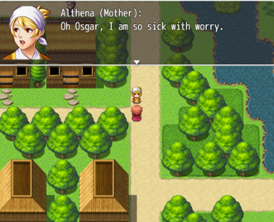
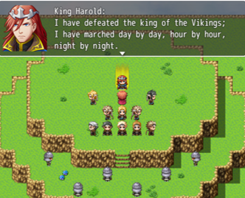
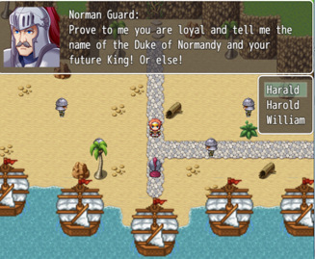
Wolsey Academy’s Learning Worlds
Our Learning Worlds make for engaging homework and class tasks. Pupils take on the role of a protagonist and adventure through a series of levels and maps. As they do so computer controlled characters pass on course specific information and different scenarios and ‘Wolsey College’ in-game tests build their confidence and skills.
Told in a format pupils love they complete a SOW specific task book at home. They then come to class ready to instantly delve deeper into the skills and analysis they need to become effective learners – and ace their exams.
Make the most of your class time and try them for free at:
www.wolseyacademy.com
thomas@wolseyacademy.com
@wolseyacademy

Slide 21
RESOURCES

Slide 22
Do not check in your book… Complete this task from memory… What can you remember about the British in India?
Cops – Write down here every detail YOU can remember.
Robbers – Move around the room and talk to others in the class – what ideas can you ‘steal’ from them?
Notes:
PRINT x 30

Slide 23
Put yourself in their shoes….
Put yourself in their shoes….
Ten Emotions you may be feeling…
Ten Emotions you may be feeling…
Write a sentence about how you are feeling
Write a sentence about how you are feeling
Notes:
PRINT AND CUT IN TWO x 16

Slide 24
FACTOR A:
Indian Nationalism: Many Indians, especially those that had been to university, were beginning to believe Indians should have more powers over their own lives. They were called Nationalists and they created their own ‘Indian National Congress’ – a place to meet, discuss ideas and make demands of the British.
DATE:
FACTOR B:
World War I: Millions of Indians volunteered to fight for the British Empire during the First World War. They thought the British would take them seriously and show respect for their efforts. When the British did not change their attitude much many of these ex-soldiers felt betrayed and angry.
DATE:
FACTOR C:
British ‘Commission’ into Home Rule: Britain sent a team of politicians to India to investigate how India could be given more control over itself. Many Indians hoped they would be given ‘Home Rule’ and treated like the other colonies – Canada, Australia and New Zealand. When nothing happened Indians felt betrayed again.
DATE:
FACTOR D:
Rowlatt Act: A British politician was worried about the Indians protesting – so they passed a new law which brought the country under ‘Marshall Law’. This meant the British Army was in complete control. Indians were not allowed out of their houses at certain times of the day and were banned from meeting together in large groups.
DATE:
FACTOR E:
Amritsar Massacre: Angry at the Rowlatt act a group of several hundred Indians met to protest. The British Army opened fire on them killing 400 people including some woman and children that had joined.
DATE:
Notes:
PRINT AND CUT UP X 15

Slide 25
Key word:
Write a definition:
Glossary & Keyword Spotlight
Write a sentence in which the word is used correctly:
Create a question where the keyword is the answer:
Got it!
Almost!
Not Yet!
Draw a small picture to help you remember this keyword:
What other words are like this?
Notes:
PRINT x 5

