Slide 1
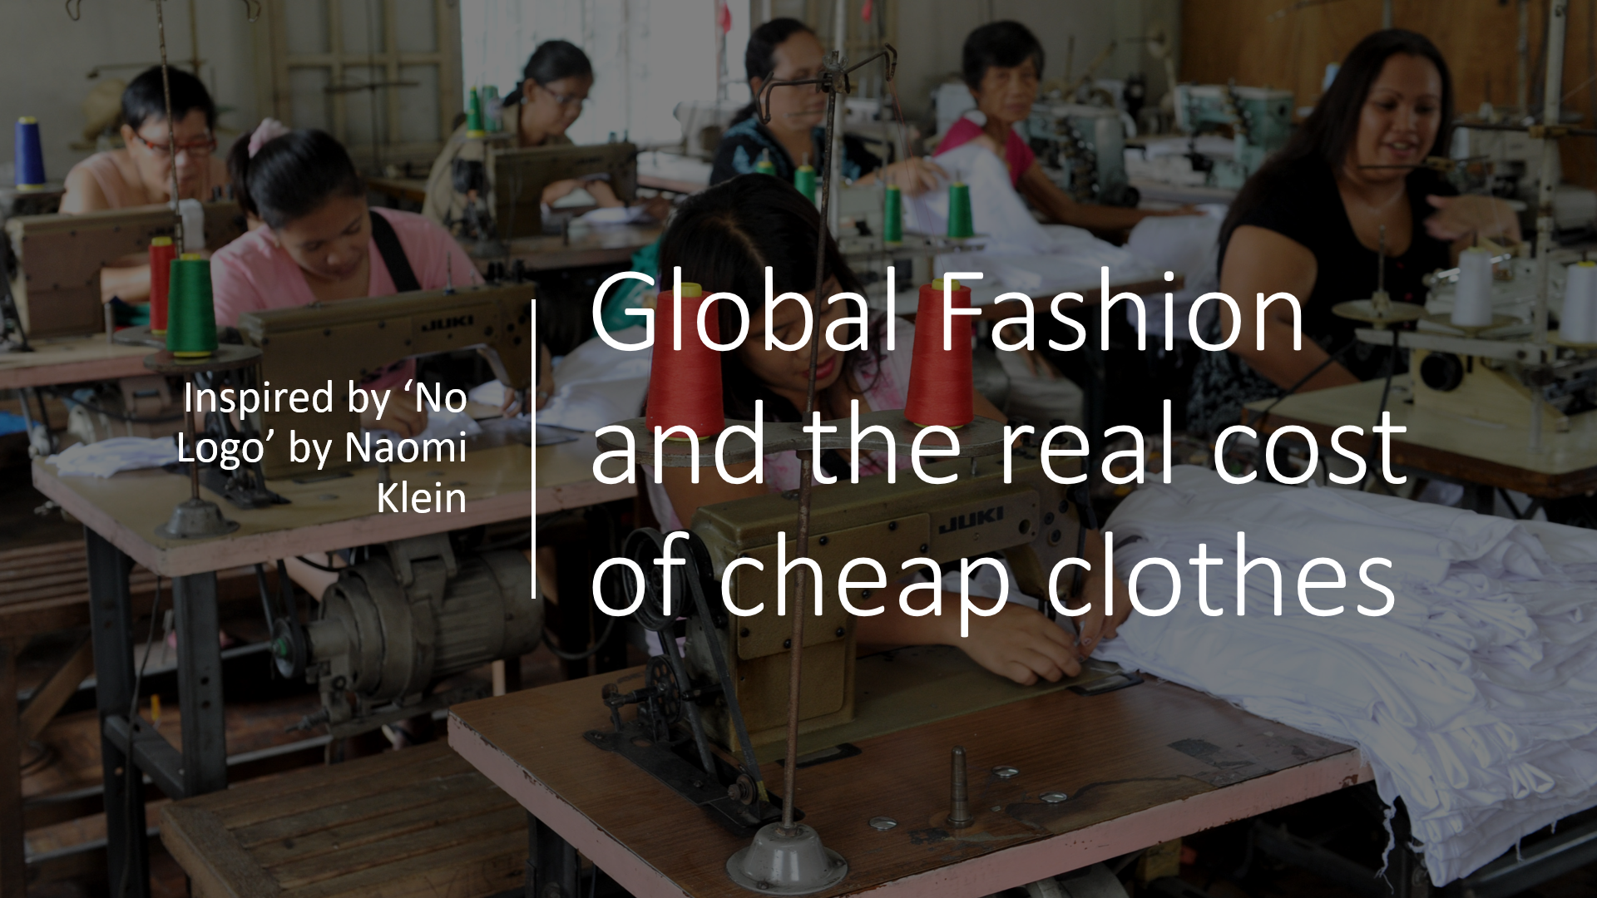

Slide 2
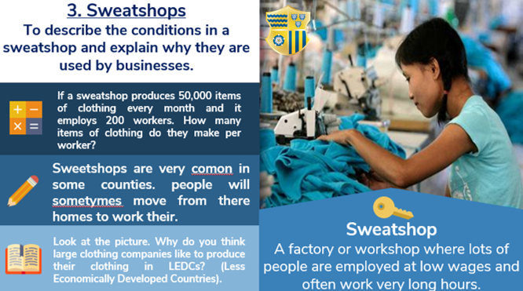

Slide 3
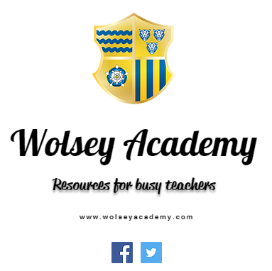

Slide 4
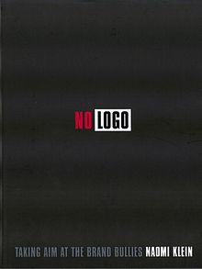
Inspired by…
No Logo
By Naomi Klein
Part of a wider ‘Inspired By’ lesson series available at www.wolseyacademy.com/inspired-by

Slide 5

Watch the video
Carefully make notes under these headings… https://youtu.be/B0TQR1kVs0k
What does Klein think about brand names?
VIDEO NOTES
How does Klein think brands are linked to sweatshops?
What else do you notice?

Slide 6
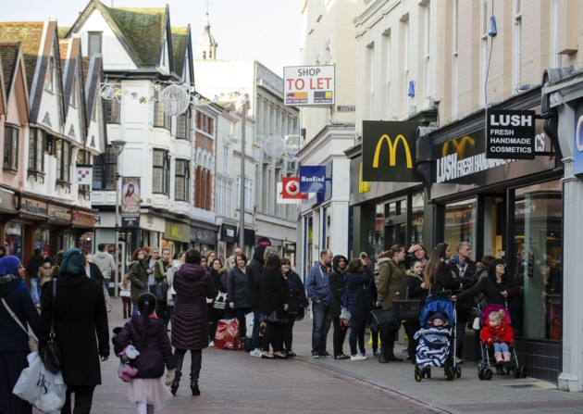
Agree of disagree?
Adverts force young people to buy expensive brands
I’m more interested in what my clothes look like than where they come from
People working in fashion are very glamorous
The fashion industry doesn’t damage the environment
There aren’t many jobs in fashion
It’s better to have a poorly paid job than no job at all.
Jobs in fashion aren’t well paid
Create a continuum in your book using strongly agree and strongly disagree and then placing these statements along the line

Slide 7
No Logo by Naomi Klein.
This book was published in 1999 and drew attention to the poor conditions in sweatshops around the world.
Read through the quotes (see resources) and perform the following tasks:
READ THE PASSAGE
DICUSS WHAT YOU CAN LEARN ABOUT SWEAT SHOPS
WRITE A PEE PARAGAPH USING THE PASSAGE AS YOUR ‘EVIDENCE’
Num/Lit Settler
Extra Credit: How you do you think people responded to Naomi Klein’s book? Who would have welcome it and why? Can you think of any ‘counter-arguments’?

Slide 8

Naomi needs your help.
It has been twenty years since the release of Naomi Kelin’s bestselling book ‘No Logo’.
In that time how far have sweatshops improved? Or have they got worse?
Naomi Klein needs your help to research and write the outline of a new book investigating the changes.

Slide 9
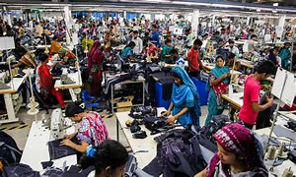
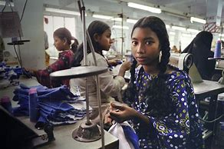
Naomi needs your help.
Step One: Research
Research online into sweatshops.
Find a ‘case study’ – one particular sweatshop and write down as many details about it as you can. If you can find pictures as well – great.
2

Slide 10
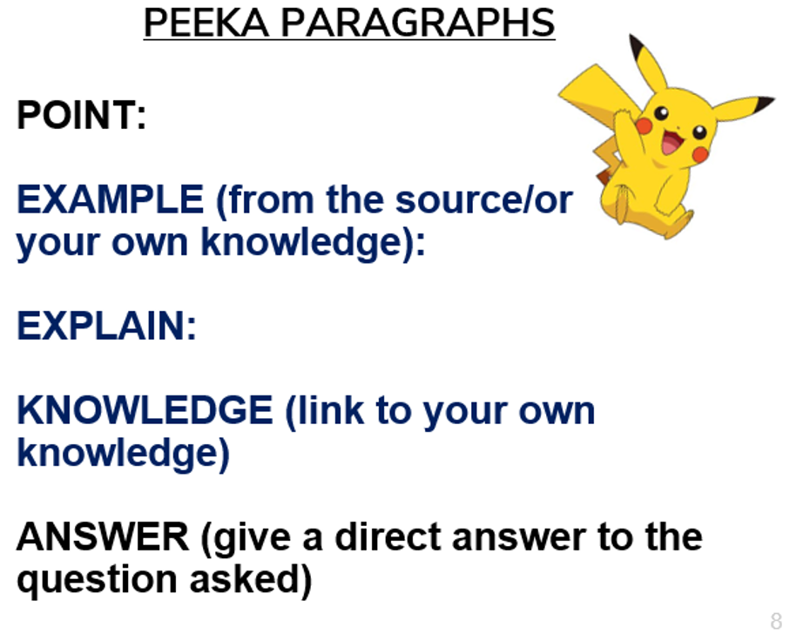
Write the outline.
Can you use
PEEKA
Paragraphs
to help?
Introduction: What were sweatshops like twenty years ago? (you can use some of the quotes from No Logo).
What has changed in public opinion?
What has changed with the ‘big brands’ (For example have Nike or GAP changed how they make their clothes?)
A modern day case study – give details of a current Sweatshop.
Conclusion: Overall – do you think anything has improved since Naomi Klein wrote her book ‘No Logo’?

Slide 11

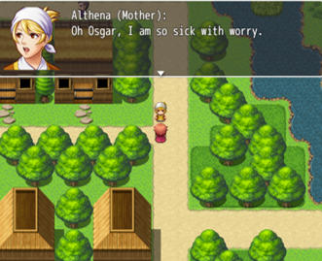
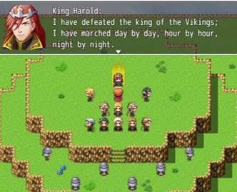
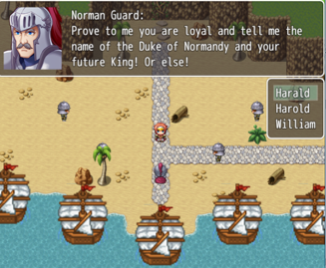



Wolsey Academy’s Learning Worlds
Our Learning Worlds make for engaging homework and class tasks. Pupils take on the role of a protagonist and adventure through a series of levels and maps. As they do so computer controlled characters pass on course specific information and different scenarios and ‘Wolsey College’ in-game tests build their confidence and skills.
Told in a format pupils love they complete a SOW specific task book at home. They then come to class ready to instantly delve deeper into the skills and analysis they need to become effective learners – and ace their exams.
Make the most of your class time and try them for free at:
www.wolseyacademy.com
thomas@wolseyacademy.com
@wolseyacademy

Slide 12
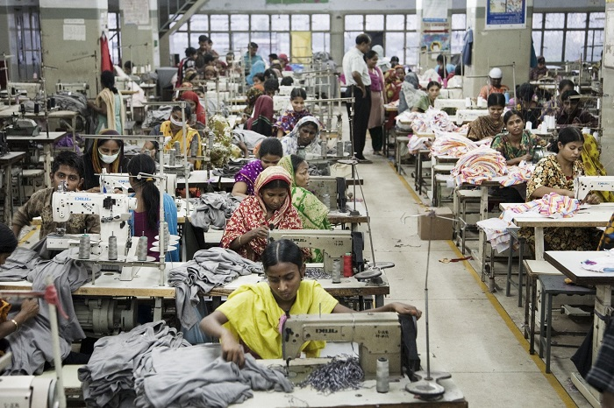

Check out the full Global Fashion SOW
On my last night in Cavite, I met a group of six teenage girls in the workers' dormitories who shared a sixby-eight-foot concrete room: four slept on the makeshift bunk bed (two to a bed), the other two on mats spread on the floor. The girls who made Aztek, Apple and IBM CD-ROM drives shared the top bunk; the ones who sewed Gap clothing, the bottom. All were the children of farmers, away from their families for the first time.
Click here

Slide 13
RESOURCES

Slide 14
On my last night in Cavite, I met a group of six teenage girls in the workers' dormitories who shared a sixby-eight-foot concrete room: four slept on the makeshift bunk bed (two to a bed), the other two on mats spread on the floor. The girls who made Aztek, Apple and IBM CD-ROM drives shared the top bunk; the ones who sewed Gap clothing, the bottom. All were the children of farmers, away from their families for the first time.
“In the rows of virtually identical giant shed-like structures, one factory stood out: the name on the white rectangular building said "Philips," but through its surrounding fence I could see mountains of Nike shoes piled high. It seems that in Cavite, production has been banished to our age's most worthless status: its factories are unbrandable, unswooshworthy; producers are the industrial untouchables”
Women are often fired from their zone jobs in their mid-twenties, told by supervisors that they are "too old," and that their fingers are no longer sufficiently nimble. This practice is a highly effective way of minimizing the number of mothers on the company payroll.
On my last night in Cavite, I met a group of six teenage girls in the workers' dormitories who shared a sixby-eight-foot concrete room: four slept on the makeshift bunk bed (two to a bed), the other two on mats spread on the floor. The girls who made Aztek, Apple and IBM CD-ROM drives shared the top bunk; the ones who sewed Gap clothing, the bottom. All were the children of farmers, away from their families for the first time.
Work in the zone is characterized by this brutal combination of tremendous intensity and nonexistent job security. Everyone works six or seven days a week, and when a big order is due to be shipped out, employees work until it is done. Most workers want some overtime hours because they need the money, but the overnight shifts are widely considered a burden. Refusing to stay, however, is not an option. For instance, according to the official rule book of the Philips factory (a contractor that has filled orders for both Nike and Reebok), "Refusal to render overtime work when so required" is an offence "punishable with dismissal."

