Slide 1
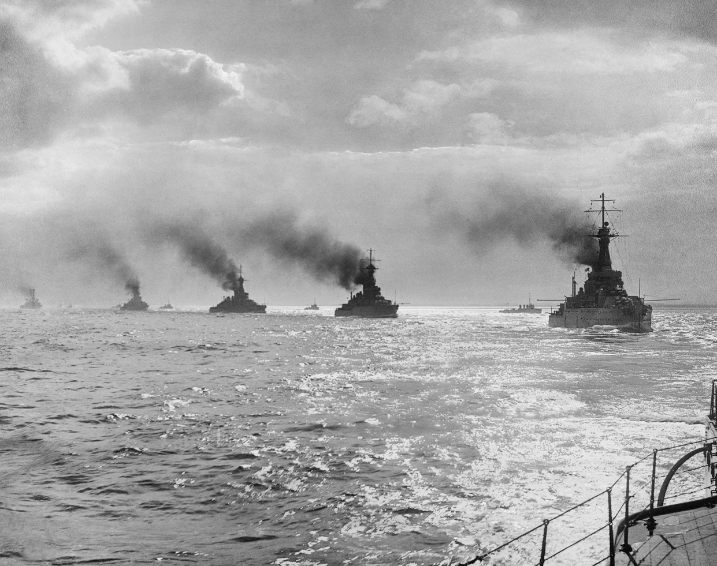
British Naval Blockade 1914 - 1919
The blockade began at the very beginning of the war in August 1914 and lasted 8 months after the signing of the armistice and ended in July 1919. How many months did the blockade last?
The impact the ware had on the civillian population of germany was catastrophic and it contributed to the deaths of over 700,000 Germanes.
SPAG corrections…
Notes:
This image was taken during the battle of Jutland so isn’t strictly speaking to with the blockade – but it’s a good picture that gets across the idea of a string of ships – in reality the blockading ships would never have been this close together.

Slide 2
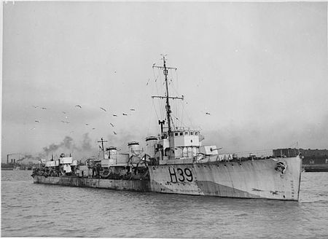
1914-1919
The British had, in comparison to other nations, a small army at the beginning of the First World War. However, it had the largest navy in the world and was keen to put it to use.
The German navy knew it would be very difficult to defeat the British navy in an open battle so they kept their biggest ships safely in port. This allowed the British to quickly create a blockade around Germany.
The blockade was to stop all supplies getting in and out of Germany to prevent their war effort. They also published a list of items considered ‘contraband’ that they refused to allow neutral countirse, like Sweden and the Netherlands, that traded with Germany.
The impact of the blockade is disputed by historians but they all agree that it made Germany weaker and life more difficult. Over 700,000 are estimated to have died from the shortages of food and materials that the blockade brought about. It was one of the major factors in bringing about Germany’s defeat.
The Naval Blockade

Slide 3
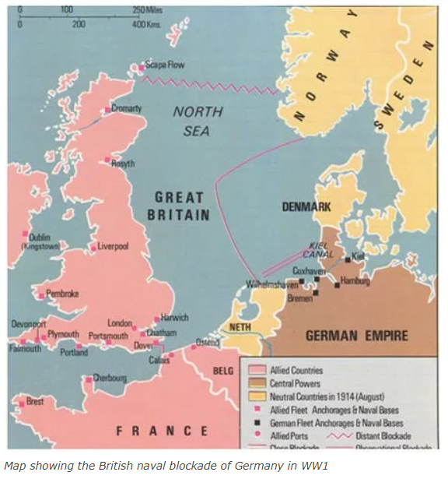
How long ago? 1914… 4 Grandmothers
Why would Britain want to blockade Germany?

Slide 4
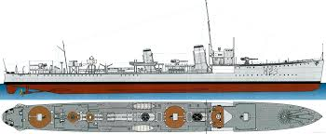
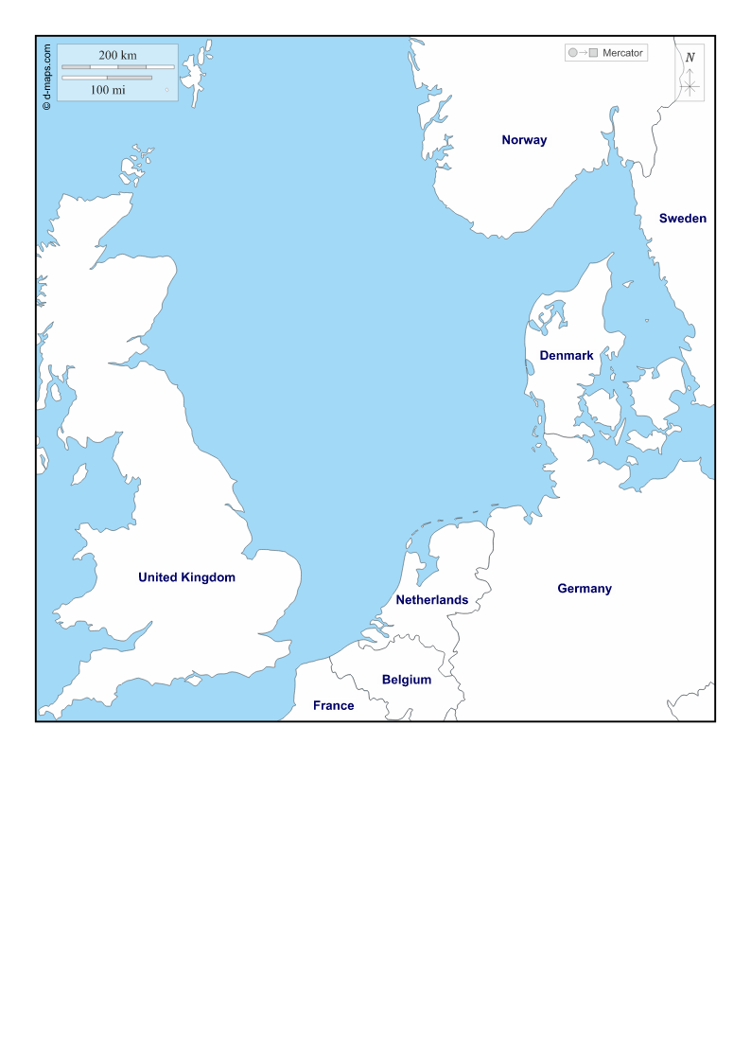
How to organise a blockade…
Battleships: Large, lots of heavy armour and guns. Able to fire long distances. Relatively slow. Designed for fighting other Battleships. The British only had 18 modern Battleships in 1914.
The Royal Navy had access to a variety of ships at the beginning of the First World War. They broke down into roughly 3 groups.
Using your maps – place the ships at your command around the North Sea to best blockade the German coastline and ships going to neutral countries like Norway, Sweden and the Netherlands.
Think – what would happen if a German ship ‘broke’ through the blockade? How would it be caught? What would happen if the German Fleet, with all their Battleships, sailed out to fight off the blockade? How would you be ready for this?
Destroyers: Small, fast and lightly armed. Designed to intercept small boats and provide a defence screen around the Battleships. The Royal Navy had 221 in 1914.
Submarines. Very slow, armed with torpedo's. Small crews, designed to sneak up on enemy warships. Britain had 80 submarines in 1914.

Slide 5
Use a pencil to draw on the grid where you would place each ship to make a secure blockade.
Remember, you have to blockade the neutral countries of Norway, Sweden and the Netherlands to.
Think – How can you ‘block’ ships from entering Germany? what would happen if a German ship ‘broke’ through the blockade? How would it be caught? What would happen if the German Fleet, with all their Battleships, sailed out to fight off the blockade? How would you be ready for this?
First World War Naval Blockade 1914 - 1919
Destroyers
Battleships
D
D
D
B
B
D
D
D
D
D
D
B
B
D
D
D
B
B
D
D
D

Slide 6
Why would the goods below be stopped from entering Germany by the British? What could they be used for?
Wheat
Oil
Rubber
Animal Feed
Coal
Iron Ore

Slide 7
The British Blockade 1914 - 1919
EXTENSION
Questions
What is the difference between 'absolute contraband' and 'conditional contraband’?
Why would the USA not like the British Blockade?
What eventually led the USA to support the blockade?
What was the Royal Navy's 'Trafalgar Syndrome'
What problems did the British have with conducting a 'close blockade'?
What happened to exports from German & Austria/Hungary to the USA? Why would this hurt the Central Powers?
Notes:
If link is broken search for: The British Naval Blockade of Germany I THE GREAT WAR Special

Slide 8
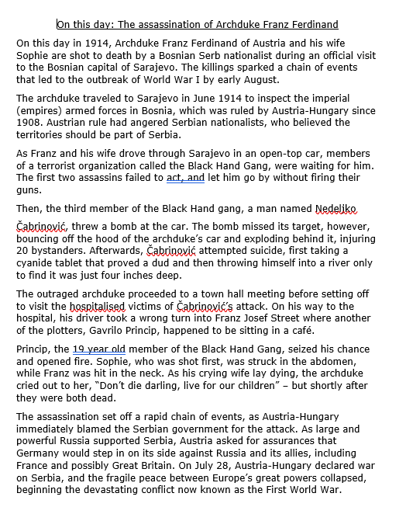
Guided Reading Task
1. Give each paragraph a subheading
2. Write down 3 facts for each paragraph as bullet points.
Click here to access
Notes:
A shorter and more accessible text can be found here: https://www.bbc.co.uk/bitesize/guides/zx33p39/revision/1

Slide 9
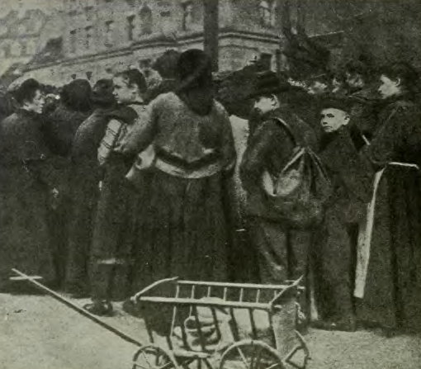
Consequences of the British Blockade
By 1915, Germany's imports had fallen by 55% from its prewar levels and the exports were 53% of what they had been in 1914. Apart from leading to shortages in vital raw materials such as coal and nonferrous metals, the blockade also deprived Germany of supplies of fertiliser that were vital to agriculture. That led to staples such as grain, potatoes, meat and dairy products becoming so scarce by the end of 1916 that many people were obliged to instead consume ersatz products, including Kriegsbrot ("war bread") and powdered milk. The food shortages caused looting and riots not only in Germany but also in Vienna and Budapest.
The food shortages were so severe that by the autumn of 1918, Austria-Hungary hijacked barges on the Danube full of Rumanian wheat bound for Germany, which in turn threatened military retaliation. Also, during the winter of 1916 to 1917, there was a failure of the potato crop, which resulted in the urban population having to subsist largely on Swedish turnips. That period became known as the Steckrübenwinter or Turnip Winter.
What did the most harm to German agricultural production?
What difficulties did it cause between the members of the Grand Alliance?
What did the population have to rely on during 1916-17?

Slide 10
RECAP QUESTIONS…
What did the British do in 1914 with its Navy in the North Sea? How did they deploy (set it out)?
What impact did it have on neutral countries like the USA?
What impact did it have on Germany?
What did Germany begin to do in 1916 that brought the USA into the war?
How did the British and Americans protect their cargo ships across the Atlantic?

Slide 11
Make a judgement. How significant was the British Naval Blockade on the outcome of the First World War?
Write a PEE paragraph explaining how significant you think the British Blockade was on the outcome of the First World War.
Can we come up with some sentence starters as a class?
POINT
EVIDENCE
EXPLAIN
Num/Lit Settler
Extra Credit: Write another PEE paragraph explaining the costs it might have caused the British.

Slide 12
RESOURCES

Slide 13
Give each paragraph a subheading.
The British Blockade 1/4
The British blockade of Germany from 1914-1919 was one of the largest and most complex undertakings attempted by either side during the First World War. While Britain employed considerable resources in other areas of the conflict, the blockade became the source of the United Kingdom's greatest efforts during the war. As Eric Osborne noted, "It is true that the exploits of the British Army and Royal Navy aided greatly in the conflict, but Britain's greatest contribution to the allied cause was the largely unseen economic pressure occasioned by naval supremacy through the imposition of a blockade of Germany."¹
Three Key Facts…
1.
2.
3.
Go Further…
Do your own research and add in your own details to this paragraph…

Slide 14
Give each paragraph a subheading
The British Blockade 2/4
This of course was Britain's traditional area of expertise, and something they had used considerably in the past. The British mindset was summed up by Greg Kennedy when he noted that Britain's two major allies - France and Russia - possessed large modern armies that were best suited to conducting a land war. Britain conversely maintained the world's largest navy, but had only limited trained land forces available.² Thus the British could best direct their efforts to blockading Germany at sea, while providing smaller numbers of troops on the continent to help bolster the western front..
Three Key Facts…
1.
2.
3.
Go Further…
Do your own research and add in your own details to this paragraph…

Slide 15
Give each paragraph a subheading.
The British Blockade 3/4
Thus Royal Navy planners recognized early that neutralizing the German navy from the outset, and preventing them from forming their own blockade of the United Kingdom, was the key to ensuring their own survival and success in the war. The new plan, designated as the 'observational blockade,' placed fast moving cruisers and destroyers from the southwestern tip of Norway to the center of the North Sea, and then down south to the coast of Holland. The Grand Fleet would once again be stationed further back ready to intercept the High Seas Fleet, and watch for merchant ships attempting to slip the blockade (see Figure 1.2 in appendix).⁵.
Three Key Facts…
1.
2.
3.
Go Further…
Do your own research and add in your own details to this paragraph…

Slide 16
Give each paragraph a subheading.
The British Blockade 4/4
This second strategy was finally revised one last time in July, 1914. The observational blockade became the 'distant blockade.' In this final revision, the two entrances into the North Sea were blockaded first between the Dover Straits and northern France, and then between Norway and Scotland (see Figure 1.3 in appendix). As Kemp noted, this final operational change was described in the new official War Plan as to have the movement of ships "be sufficiently frequent enough and sufficiently advanced to impress upon the enemy that he cannot at any time venture far from his home ports without such serious risk of encountering an overwhelming force."⁶ The distant blockade thus covered two operational concerns - stopping merchant ships from reaching German ports, and giving German Naval leaders visual stimuli that should they set sail, it was at their own peril.
Three Key Facts…
1.
2.
3.
Go Further…
Do your own research and add in your own details to this paragraph…

Slide 17
The British Naval Blockade: Printable Version
The British blockade of Germany from 1914-1919 was one of the largest and most complex undertakings attempted by either side during the First World War. While Britain employed considerable resources in other areas of the conflict, the blockade became the source of the United Kingdom's greatest efforts during the war. As Eric Osborne noted, "It is true that the exploits of the British Army and Royal Navy aided greatly in the conflict, but Britain's greatest contribution to the allied cause was the largely unseen economic pressure occasioned by naval supremacy through the imposition of a blockade of Germany.“
This of course was Britain's traditional area of expertise, and something they had used considerably in the past. The British mindset was summed up by Greg Kennedy when he noted that Britain's two major allies - France and Russia - possessed large modern armies that were best suited to conducting a land war. Britain conversely maintained the world's largest navy, but had only limited trained land forces available.² Thus the British could best direct their efforts to blockading Germany at sea, while providing smaller numbers of troops on the continent to help bolster the western front..
Thus Royal Navy planners recognized early that neutralizing the German navy from the outset, and preventing them from forming their own blockade of the United Kingdom, was the key to ensuring their own survival and success in the war. The new plan, designated as the 'observational blockade,' placed fast moving cruisers and destroyers from the southwestern tip of Norway to the center of the North Sea, and then down south to the coast of Holland. The Grand Fleet would once again be stationed further back ready to intercept the High Seas Fleet, and watch for merchant ships attempting to slip the blockade (see Figure 1.2 in appendix).⁵.
This second strategy was finally revised one last time in July, 1914. The observational blockade became the 'distant blockade.' In this final revision, the two entrances into the North Sea were blockaded first between the Dover Straits and northern France, and then between Norway and Scotland (see Figure 1.3 in appendix). As Kemp noted, this final operational change was described in the new official War Plan as to have the movement of ships "be sufficiently frequent enough and sufficiently advanced to impress upon the enemy that he cannot at any time venture far from his home ports without such serious risk of encountering an overwhelming force."⁶ The distant blockade thus covered two operational concerns - stopping merchant ships from reaching German ports, and giving German Naval leaders visual stimuli that should they set sail, it was at their own peril.

Slide 18
Key word:
Write a definition:
Glossary & Keyword Spotlight
Write a sentence in which the word is used correctly:
Create a question where the keyword is the answer:
Got it!
Almost!
Not Yet!
Draw a small picture to help you remember this keyword:
What other words are like this?

