Slide 1
Year 8
REVISION
First look Second look Nailed it!
Keywords
Revolution: The overthrow of one government or system and its replacement by another.
Cholera: A disease that spreads through contaminated water. Killed thousands during the Industrial Revolution.
Luddite: A group of workers who smashed the machines used in factories because they were afraid of being replaced by them.
Now try this
Create ‘flash cards’ with the keyword on one side and the definition on the back. Practice saying the definition before flipping the card over to check you are correct. Get someone at home to test you!

Slide 2


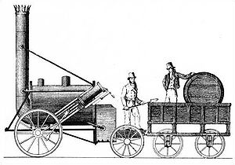

Year 8
REVISION
First look Second look Nailed it!
Industrial Revolution
Important individuals and events
1771, Richard Arkwright built the first water powered mill (factory).
It produced cotton and fabric hundreds of times faster than previously possible.
Mass production made many products cheaper to buy.
Factories put talented weavers out of business.
Factories created ‘urbanisation’ and the growth of large cities like Manchester and Liverpool.
1829, Robert Stephenson won the competition to design the steam train to operate on the Liverpool to Manchester Railway. It was not the first steam train but it was the first reliable design to be used on a large scale.
It allowed armies to move faster, factories to buy and sell products further afield and people to travel on holidays for the first time. It even forced people to synchronise the clocks!
1858, The Great Stink in London.
During the summer of 1858 the river Themes radiated an overwhelming stench. Human, animal and industrial waste was being dumped into the river.
The smell was so bad that Parliament had to soak their curtains in chloride of lime to try and hide the smell.
In just 13 days Parliament drafted and passed a law to build sewers in London and clean up the Themes.
Now try this
Look/Cover/Write/Check these basic facts until you can remember them without looking.

Slide 3



Year 8
REVISION
First look Second look Nailed it!
Industrial Revolution
Important individuals and organisations
1858, Joseph Bazalgette was given money by government to build a sewer system in London.
A response to London’s ‘Great Stink’ and the growth of the deadly cholera disease in the city.
Bazalgette’s sewers greatly increased public health by taking waste water away and bringing fresh water in.
Allowed cities to grow much bigger than ever before.
Copied by other towns and cities across the country.
1813, John Snow was doctor who studied in London.
He studied cholera and believed it was transmitted via infected water, not miasma, which was the thinking at the time.
He removed the handle of the water pump in Broad Street and helped stop the disease.
He could not explain the science behind his theory so many people did not believe him until Germ Theory was developed in the 1860s.
1903, Emmaline Pankhurst founded the Women’s Social and Political Union (The Suffragettes).
Believed in ‘deeds not words’ to make people aware of how unfairly women were being treated.
She split opinion, some thought she was a hero, others that she was a criminal.
By agreeing to help in WW1 she impressed the government who eventually started to give women the vote in 1918.
Now try this
Which was the most important? Pick one and write a paragraph that explains why they were the most important. Use evidence and compare the individual to others to prove your point.

Slide 4


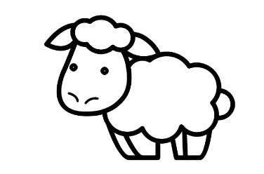
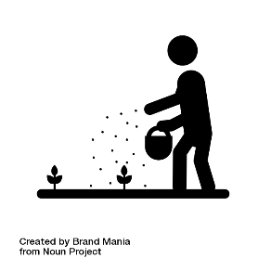


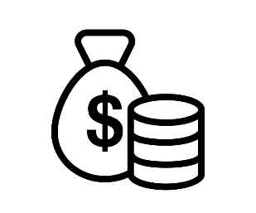


EAL ASSISSTANCE SHEETS
1. Can you match the words to the correct image?
Sheep
Farmer
Factory
Challenge: Write a paragraph using all of the words above. Make sure it makes sense!
1. Can you match the words to the correct image?
Crops
Seeds
Vaccine
Challenge: Write a paragraph using all of the words above. Make sure it makes sense!
1. Can you match the words to the correct image?
Village
Profits
Thread
Challenge: Write a paragraph using all of the words above. Make sure it makes sense!

Slide 5


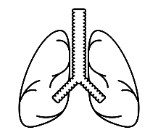

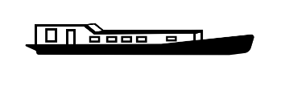

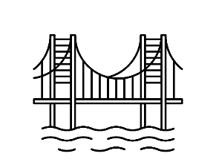

1. Can you match the words to the correct image?
Lungs
Miner
Gas lamp
Challenge: Write a paragraph using all of the words above. Make sure it makes sense!
1. Can you match the words to the correct image?
Railway
Steam Train
Canal boat
Challenge: Write a paragraph using all of the words above. Make sure it makes sense!
1. Can you match the words to the correct image?
Railway
Bridge
Inventor
Challenge: Write a paragraph using all of the words above. Make sure it makes sense!

Slide 6


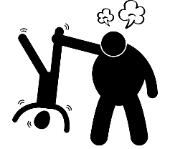
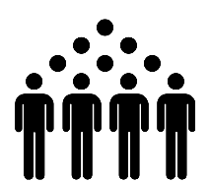
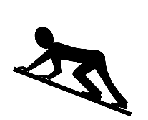



1. Can you match the words to the correct image?
Morse Code
Flushing toilet
Inventor
Challenge: Write a paragraph using all of the words above. Make sure it makes sense!
1. Can you match the words to the correct image?
Population
Crawl
Beaten
Challenge: Write a paragraph using all of the words above. Make sure it makes sense!
1. Can you match the words to the correct image?
Letter
Contaminate
Disease
Challenge: Write a paragraph using all of the words above. Make sure it makes sense!

Slide 7
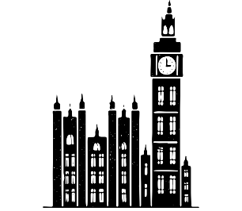





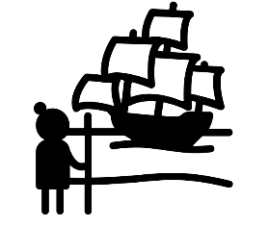


1. Can you match the words to the correct image?
Magazine
Parliament
Satirical
Challenge: Write a paragraph using all of the words above. Make sure it makes sense!
1. Can you match the words to the correct image?
Smash
Unemployed
Gang
Challenge: Write a paragraph using all of the words above. Make sure it makes sense!
1. Can you match the words to the correct image?
Conquest
Commerce
Colonisation
Challenge: Write a paragraph using all of the words above. Make sure it makes sense!

