Slide 1
Parent Projects
Building Memories – Building Minds

Slide 2
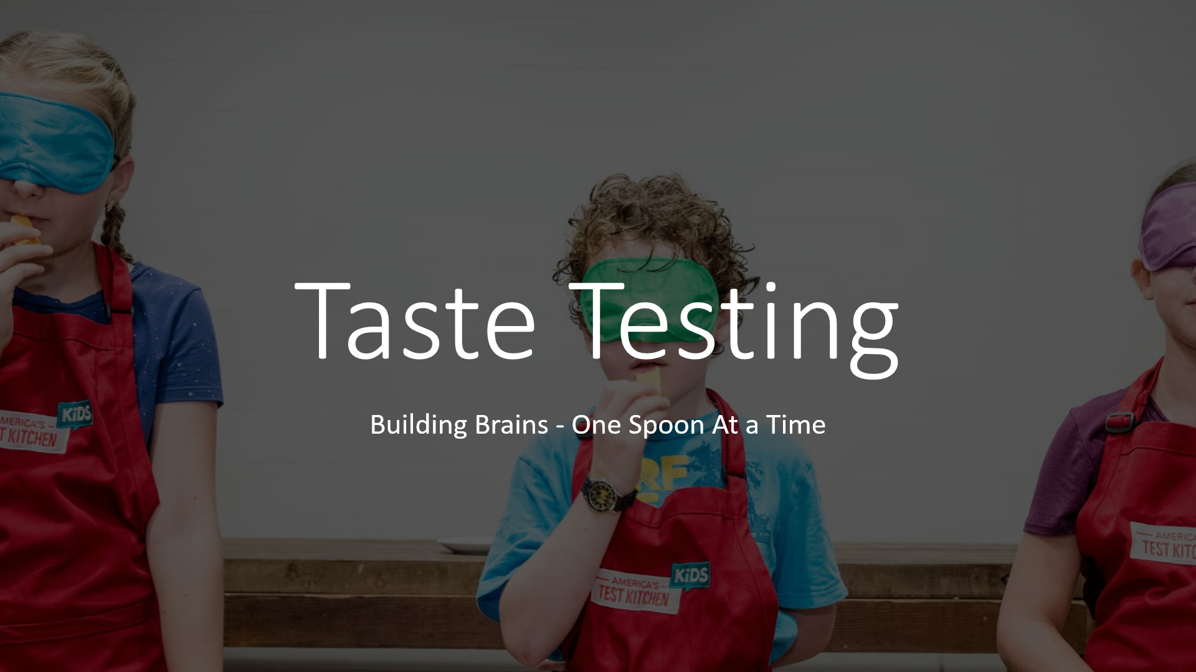
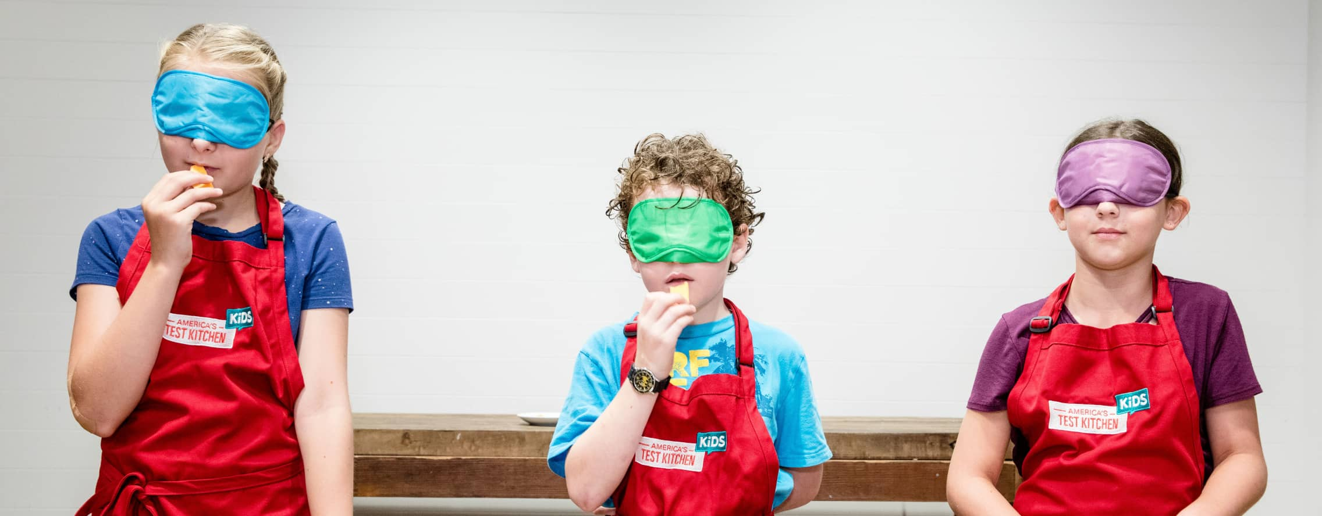
Taste Testing
Building Brains - One Spoon At a Time

Slide 4
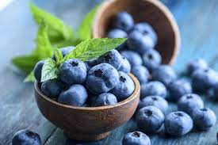
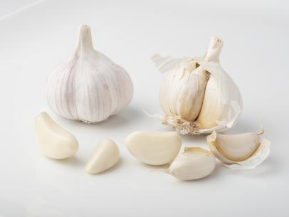
Why do taste testing with your kids?
It is LOADS of fun ☺
In introduces your child to new foods
You can do basic counting and sorting of the results.
It is a useful starting point to discuss the 5 senses.
You can go further and look at some of the organs involved!

Slide 5
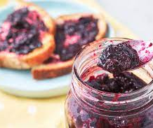
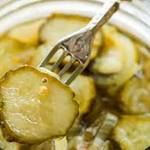
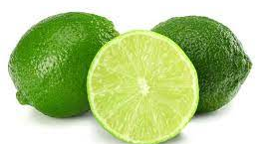
Suggested Foods
Garlic
Blueberries
Limes
Jams
Pickles
Dark Chocolate
Strong Cheeses

Slide 6
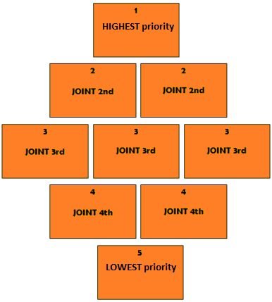
Aim for 9 different flavours: Complete a ‘Diamond 9’– your child get to pick their favourite flavours down to their least favourite and slot them into the diamond 9 (see resource for a printable version).

Slide 7
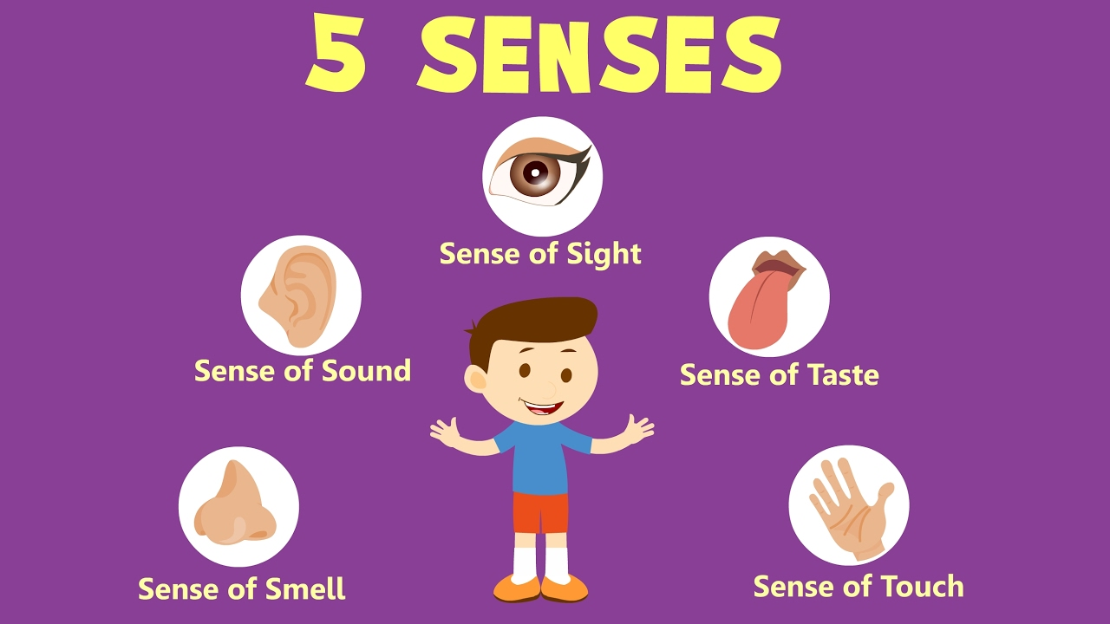
What are the 5 senses?
Can you guess them?
Can you give an example of each?
Quiet
Rough
Sour
Bright
Musty
Which senses do these words apply too?

Slide 8
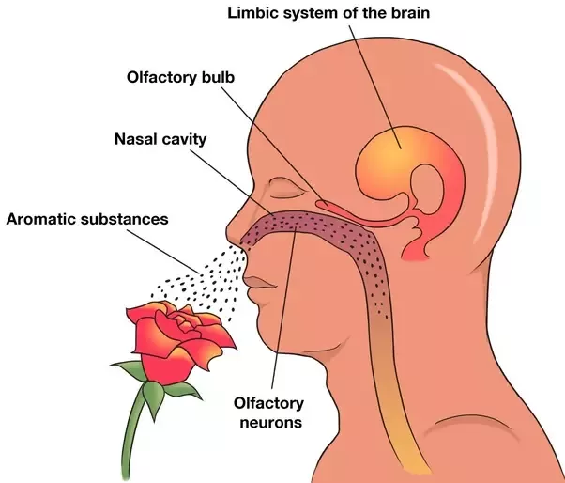
How do we smell?
What is floating in the air for us to smell?
What do ‘nose hairs’ do?
What does the Olfactory membrane do?
What are dogs better at than humans?

Slide 9
Enjoy!
Picture credit: American Test Kitchen here

Slide 10
See if your child gets the joke…

Slide 12
RESOURCES

Slide 13
