Slide 1
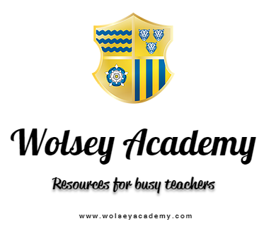






Slide 2
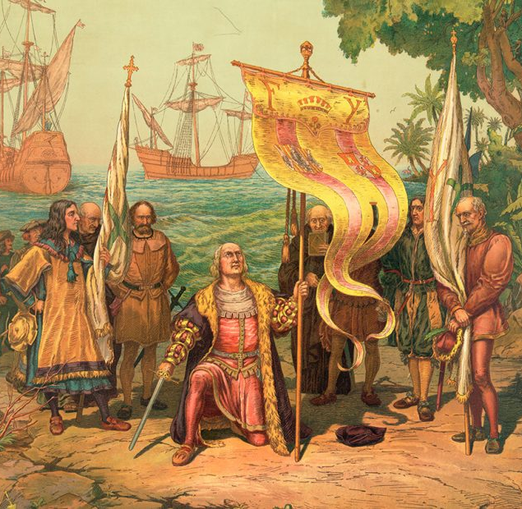
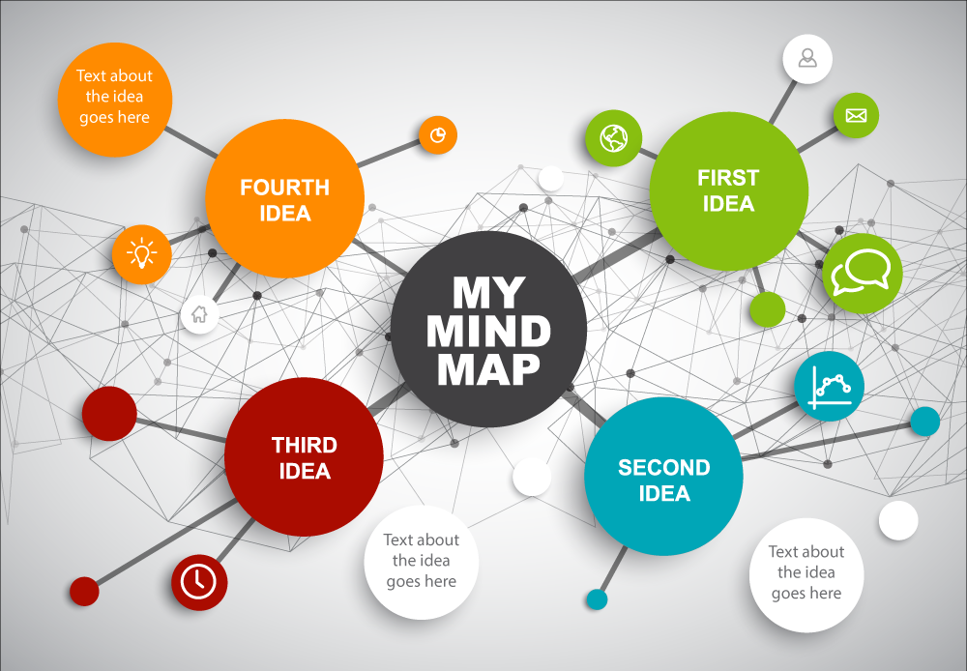
Columbus Hero or Villain?
What will we do today?
Prepare for a debate on the legacy of Christopher Columbus by studying sources.
To write two PEEKA paragraphs in support or against Columbus.
Make a mind map about all the things you think you know about Columbus.

Slide 3
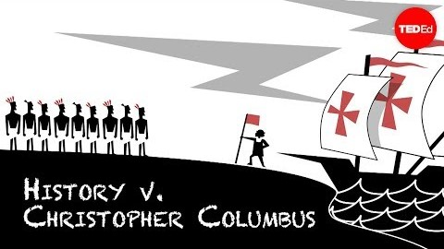
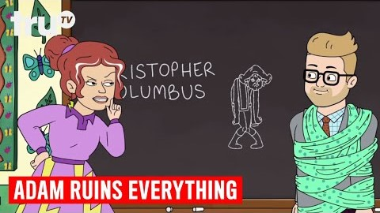
HERO OR VILLAIN?
What evidence is there to suggest he was successful?
What evidence is there to suggest he was a hero?
What evidence is there to suggest he was a villain?
Is being a hero different to being a success?
Are we judging Columbus by the moral standards of the 21st century?
Is this fair?
Should his legacy by ‘celebrated’ today?

Slide 4
Columbus – Hero or Villain?
Source | What does it suggest about Columbus?
1
2
3
4
5
Notes:
FACT FILE

Slide 5
Num/Lit Settler
COLUMBUS: Hero or Villain?
HERO | VILLAIN

Slide 6
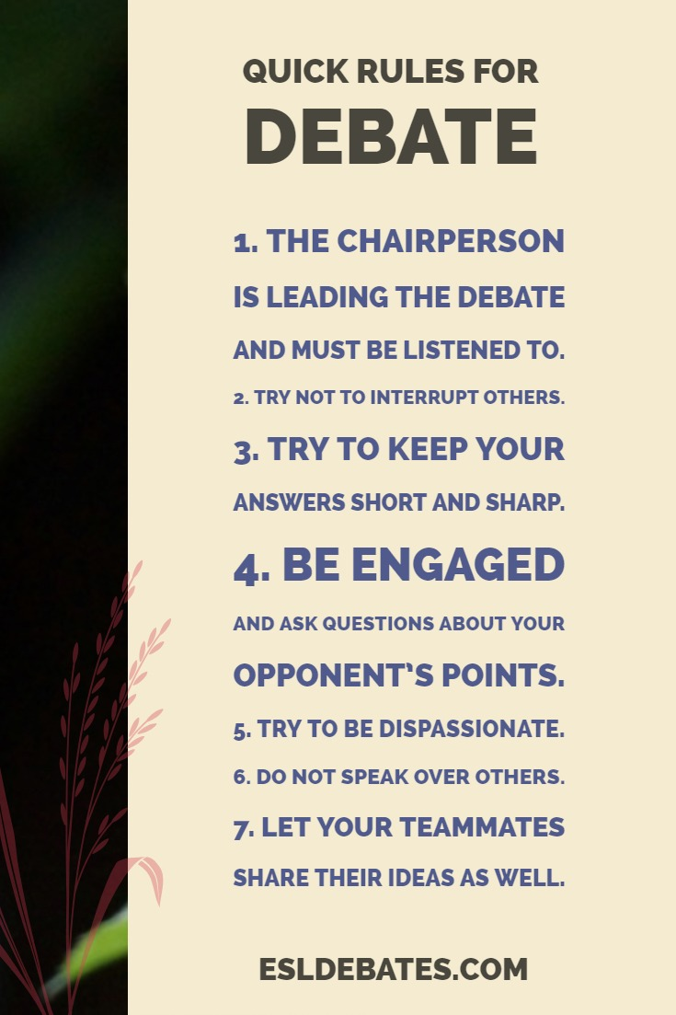
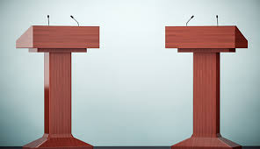
Columbus Hero or Villain?

Slide 7
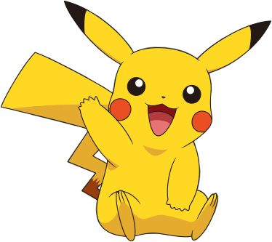
TRY TO WRITE TWO ‘PEEKA PARAGRAPHS’
Question:
Columbus – Hero or Villain?
POINT: (Identify a cause…)
EXAMPLE (Give one piece of detail/evidence to support your point):
EXPLAIN: (Explain why your point supports your argument)
KNOWLEDGE (Use your own knowledge to link to another reason that Columbus was/was not a hero)
ANSWER (give a direct answer to the question asked)
See the next two slides for a breakdown of how PEEKA paragraphs can help you.

Slide 8
Teacher modelled paragraph!
Question: Columbus – Hero or Villain?
One reason Christopher Columbus can be seen as a villain can be in the way he treated the native people of the Americas. He enslaved many of the people in what is now modern day Dominican Republic and when they tried to protest he killed them and displayed their bodies in public to scare the others. Actions like this clearly show that Columbus was a brutal and murderous man who had no care for the lives of the natives. In addition, when the Spanish King and Queen heard about his actions they were so horrified that they striped him of his title as governor. Therefore we can clearly see that Columbus was no hero to the people of the Americas or even the Spanish who had sent him.
Volunteers to read?

Slide 9
Teacher modelled paragraph!
Question: Columbus – Hero or Villain?
One reason Christopher Columbus can be seen as a villain can be in the way he treated the native people of the Americas. He enslaved many of the people in what is now modern day Dominican Republic and when they tried to protest he killed them and displayed their bodies in public to scare the others. Actions like this clearly show that Columbus was a brutal and murderous man who had no care for the lives of the natives. In addition, when the Spanish King and Queen heard about his actions they were so horrified that they striped him of his title as governor. Therefore we can clearly see that Columbus was no hero to the people of the Americas or even the Spanish who had sent him.
Point
Evidence
Explain
Knowledge (COMPARE)
Answer

Slide 10



Question: Columbus – Hero or Villain?
STRETCH:
Would a court in the 1500s rule differently on Columbus than a court today? If so, what do you think that would be? Might future generations judge us differently that we judge ourselves?
<<FIVE MINUTES>>
Christopher Columbus could be said to be a hero/villain because…
This was important because…
This meant that…
This left a legacy of…
Therefore…
This created a feeling of….
In addition…
Ask for a PEEKA sheet if you’d like one to help

Slide 11
Return to your original mind map and add in any new information you have now learned – in a different colour.

Slide 12

Scholarship/Further Reading Task (Homework).
https://u.osu.edu/christophercolumbusncc/
Summarize this article in 200 words.

Slide 13
RESOURCES

Slide 14

Written by Columbus himself in a book he wrote denfence of his own actions:
They judge me over there as they would a Governor who had gone to Sicily, or to a city or town placed under regular government, and where the laws can be observed in their entirety without fear of ruining everything; and I am greatly injured thereby. I ought to be judged as a Captain who went from Spain to the Indies to conquer a numerous and warlike people, whose customs and religion are very contrary to ours; who live in rocks and mountains, without fixed settlements, and not like ourselves; and where, by the divine will, I have placed under the dominion of the King and Queen, our sovereigns, another world, through which Spain, which was reckoned a poor country, has become the richest.
Is this soruce reliable?
What questions would we need to ask?
Notes:
FACT SHEET 1/5

Slide 15

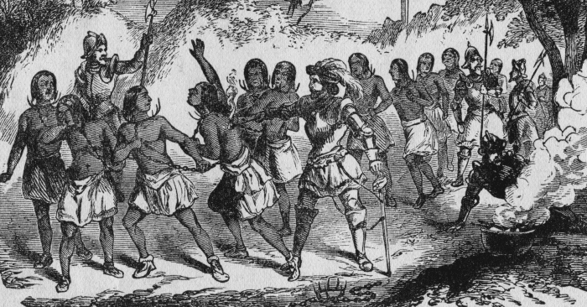
A drawing of Spanish explorers enslaving
local Native Americans in the Carribean.
Is this soruce reliable?
What questions would we need to ask?
Notes:
FACT FILE 2/5

Slide 16

From History.com
As governor and viceroy of the Indies, Columbus imposed iron discipline on what is now the Caribbean country of Dominican Republic, according to documents discovered by Spanish historians in 2005. In response to native unrest and revolt, Columbus ordered a brutal crackdown in which many natives were killed; in an attempt to deter further rebellion, Columbus ordered their dismembered bodies to be paraded through the streets.
Notes:
FACT FILE 3/5

Slide 17

Problem?
Political Reforms
From biography.com
In 1499, the Spanish monarchs got wind of the mistreatment of Spanish colonists in Hispaniola, including the flogging and executions without trial. Columbus, who was governor of the territory, was arrested, chained up, and brought back to Spain. Although some of the charges may have been manufactured by his political enemies, Columbus admitted to King Ferdinand and Queen Isabella that many of the accusations were true. Columbus was stripped of his title as governor.
Notes:
FACT FILE 4/5

Slide 18

Problem?
Weak Government
From the Washington Post
Columbus was clearly no friend of native peoples, but a document discovered 10 years ago in Simancas, Spain, suggests he was an equal-opportunity tyrant. Witnesses testified that his brief government of Hispaniola was marked by routine cruelty not only to the native Taínos but also to Spaniards who defied or mocked him. A woman who reminded Columbus that he was the son of a weaver had her tongue cut out. Others were executed for minor crimes.
Notes:
FACT FILE 5/5

Slide 19


Key word:
Write a definition:
Glossary & Keyword Spotlight
Write a sentence in which the word is used correctly:
Create a question where the keyword is the answer:
Got it!
Almost!
Not Yet!
Draw a small picture to help you remember this keyword:
What other words are like this?

Slide 20
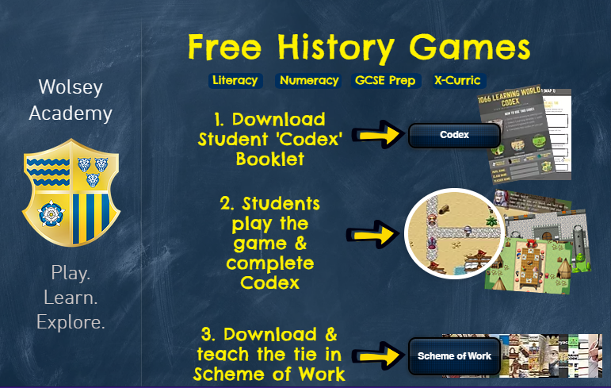

Slide 21


Slide 22



Slide 23


Slide 24
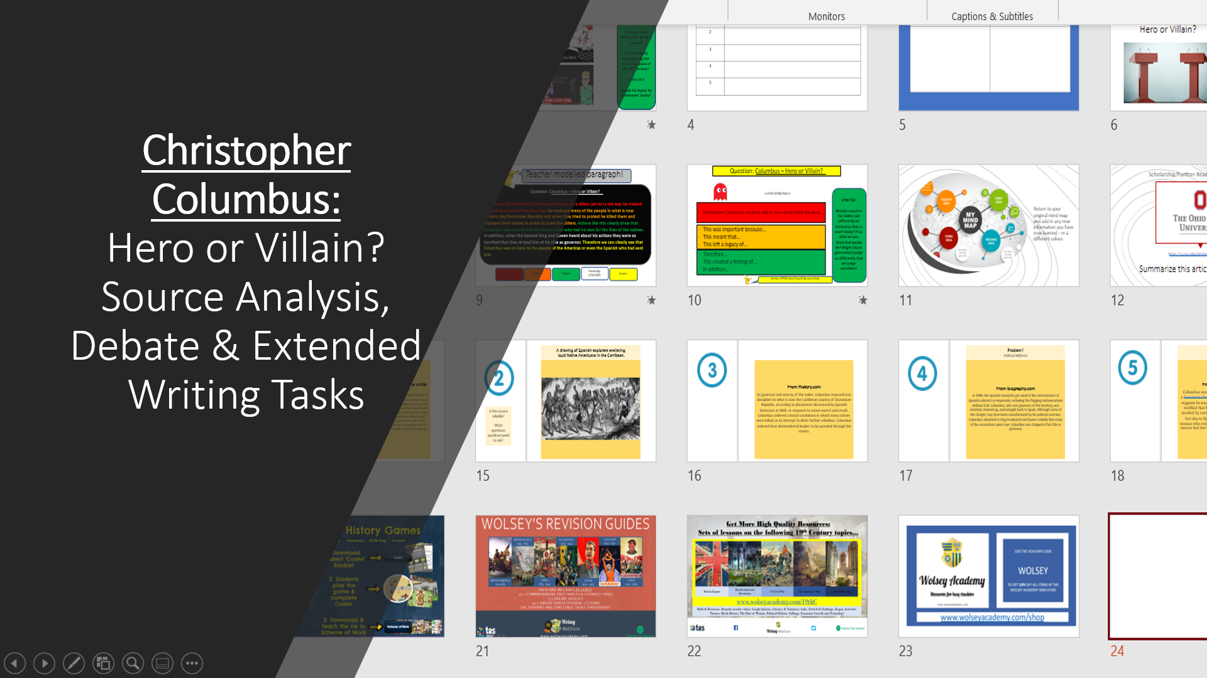
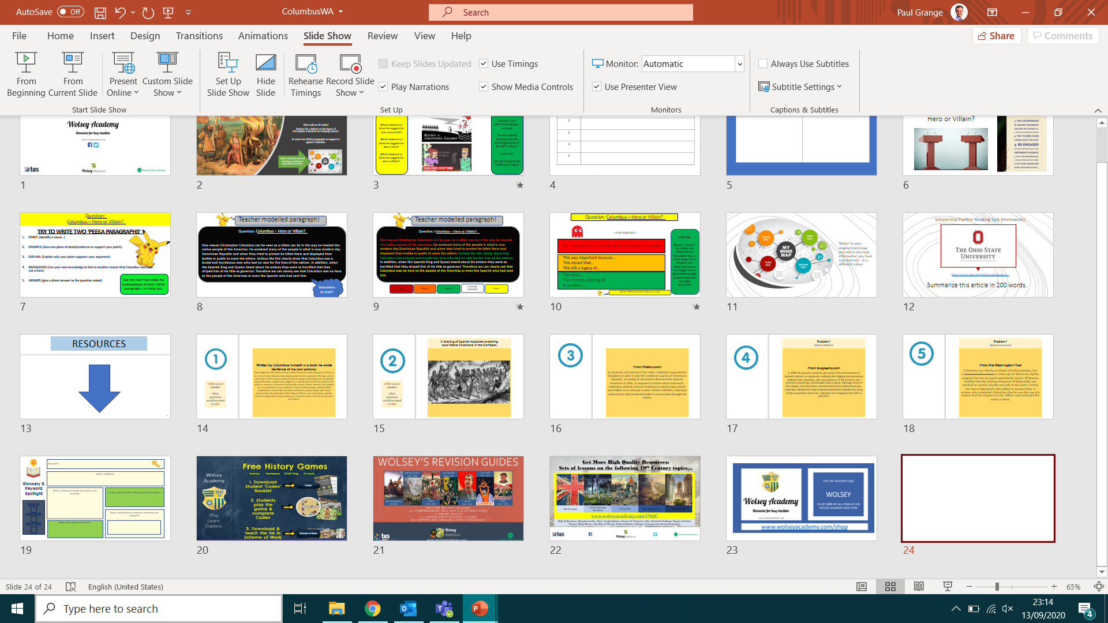
Christopher Columbus:
Hero or Villain?
Source Analysis, Debate & Extended Writing Tasks

